Slide 1

Les Deman Energy Consulting - http://www.lesdemanenergy.com/
The U.S. Shale Revolution:
Framing the Issues
PANC Annual Seminar
May 21, 2013
Les Deman – President
Notes:
Nice to be back speaking at the PANC Golf tournament.

Slide 2
Les Deman Energy Consulting - http://www.lesdemanenergy.com/
The Issues
Life’s a risk; old age will kill you if something else doesn’t do the trick earlier.
Opportunities from Shale Gas
Rapidly growing clean burning domestic fuel
Economic Benefits
Reduced Fuel Prices
Lower Carbon Emissions
Geopolitical Benefits
Costs of Shale Gas
Environmental Damage
Significant water requirement
Waste water disposal
Small earthquakes
Notes:
First, a word from your sponsor: NOTE that if you would like a copy of my monthly natural gas pricing newsletter or any other hedging assistance, please email me at this website.
MY FOCUS TODAY IS ON GAS PRODUCTION AND PRICING IN THE US. MOST OF YOU ARE PROBABLY FAMILIAR WITH THE GAS SHALE DRILLING PHENOMENON, THERE HAVE BEEN MANY STORIES ON THE GAS BOOM, BOTH ITS POSITIVE ECONOMIC EFFECTS AND THE NEGATIVES (FRACKING ISSUES, ETC.). HOWEVER THERE IS A LOT MORE GOING ON IN THE US DRILLING SCENE.

Slide 3
Les Deman Energy Consulting - http://www.lesdemanenergy.com/
U.S. Gas Production is Up 40% from 2005
Source: Energy Information Agency
Notes:
Basic gas production schematic:
1. Gas flows from gas wells (Non Associated gas)
2. And oil wells (Associated Gas)
THE TOTAL OF THESE TWO IS CALLED GROSS GAS WITHDRAWALS
Then some gas is reinjected for pressure maintenance in oil wells and some is flared.
Non hydro carbon gases are removed -- helium, hydrogen sulfide, and nitrogen. WHAT IS LEFT IS CALLED MARKETED PRODUCTION,
Then the remainder is fractionated to remove heavier gases—ethane, propane butanes and natural gasoline. This is required to make gas “pipeline quality.”
WHAT IS LEFT IS CALLED DRY GAS.

Slide 4
Les Deman Energy Consulting - http://www.lesdemanenergy.com/
Lower Prices
Source: Energy Information Agency and British Petroleum
Notes:
Basic gas production schematic:
1. Gas flows from gas wells (Non Associated gas)
2. And oil wells (Associated Gas)
THE TOTAL OF THESE TWO IS CALLED GROSS GAS WITHDRAWALS
Then some gas is reinjected for pressure maintenance in oil wells and some is flared.
Non hydro carbon gases are removed -- helium, hydrogen sulfide, and nitrogen. WHAT IS LEFT IS CALLED MARKETED PRODUCTION,
Then the remainder is fractionated to remove heavier gases—ethane, propane butanes and natural gasoline. This is required to make gas “pipeline quality.”
WHAT IS LEFT IS CALLED DRY GAS.

Slide 5
Les Deman Energy Consulting - http://www.lesdemanenergy.com/
Economic Benefits
Texas & Oklahoma - Barnett, Haynesville & Woodward Shale Benefits 2004+
Added over 180,000 energy jobs in Texas
Added about 40,000 energy jobs in Oklahoma
Pennsylvania - Marcellus Shale Benefits 2009+
Double digit job growth in 2010 – 2012
Supports about 103,000 jobs in 2012
Added about $14 billion to state economic activity in 2012
Added $3 billion to state and local tax revenues
Ohio - Utica Shale Benefits 2010+
Supports 38,000 jobs in 2012
$4.1 billion in economic activity
Source: Mark Green, Tale of Three Shale States, 2013
Notes:
First, a word from your sponsor: NOTE that if you would like a copy of my monthly natural gas pricing newsletter or any other hedging assistance, please email me at this website.
MY FOCUS TODAY IS ON GAS PRODUCTION AND PRICING IN THE US. MOST OF YOU ARE PROBABLY FAMILIAR WITH THE GAS SHALE DRILLING PHENOMENON, THERE HAVE BEEN MANY STORIES ON THE GAS BOOM, BOTH ITS POSITIVE ECONOMIC EFFECTS AND THE NEGATIVES (FRACKING ISSUES, ETC.). HOWEVER THERE IS A LOT MORE GOING ON IN THE US DRILLING SCENE.

Slide 6
Les Deman Energy Consulting - http://www.lesdemanenergy.com/
Lower Carbon Emissions
Source: Energy Information Agency
Notes:
Basic gas production schematic:
1. Gas flows from gas wells (Non Associated gas)
2. And oil wells (Associated Gas)
THE TOTAL OF THESE TWO IS CALLED GROSS GAS WITHDRAWALS
Then some gas is reinjected for pressure maintenance in oil wells and some is flared.
Non hydro carbon gases are removed -- helium, hydrogen sulfide, and nitrogen. WHAT IS LEFT IS CALLED MARKETED PRODUCTION,
Then the remainder is fractionated to remove heavier gases—ethane, propane butanes and natural gasoline. This is required to make gas “pipeline quality.”
WHAT IS LEFT IS CALLED DRY GAS.

Slide 7
Les Deman Energy Consulting - http://www.lesdemanenergy.com/
Geopolitical Benefits
Less reliance on gas imports from unstable regimes by our allies—Russia, North Africa
Decoupling natural gas prices from oil prices
Less reliance on oil imports from unstable regimes by our allies
U.S. military actions not based on oil issues – reduced Middle East presence
Less divisiveness on global climate change initiatives
Positive balance of trade – lower imports
Notes:
Basic gas production schematic:
1. Gas flows from gas wells (Non Associated gas)
2. And oil wells (Associated Gas)
THE TOTAL OF THESE TWO IS CALLED GROSS GAS WITHDRAWALS
Then some gas is reinjected for pressure maintenance in oil wells and some is flared.
Non hydro carbon gases are removed -- helium, hydrogen sulfide, and nitrogen. WHAT IS LEFT IS CALLED MARKETED PRODUCTION,
Then the remainder is fractionated to remove heavier gases—ethane, propane butanes and natural gasoline. This is required to make gas “pipeline quality.”
WHAT IS LEFT IS CALLED DRY GAS.

Slide 8
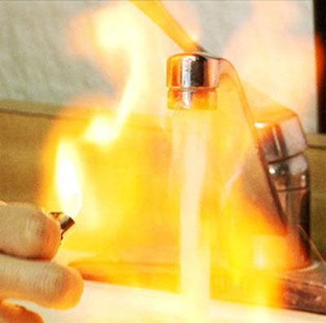
Les Deman Energy Consulting - http://www.lesdemanenergy.com/
Shale Gas – The Potential Costs
Environmental Damage
Groundwater Contamination
Earthquakes
Air Pollution
Chemical Contamination
High Water Usage
1 to 4 million gallons per well
Landowner Issues
Royalties versus Farmers/Ranchers
From HBO - Gasland
Notes:
Basic gas production schematic:
1. Gas flows from gas wells (Non Associated gas)
2. And oil wells (Associated Gas)
THE TOTAL OF THESE TWO IS CALLED GROSS GAS WITHDRAWALS
Then some gas is reinjected for pressure maintenance in oil wells and some is flared.
Non hydro carbon gases are removed -- helium, hydrogen sulfide, and nitrogen. WHAT IS LEFT IS CALLED MARKETED PRODUCTION,
Then the remainder is fractionated to remove heavier gases—ethane, propane butanes and natural gasoline. This is required to make gas “pipeline quality.”
WHAT IS LEFT IS CALLED DRY GAS.

Slide 9
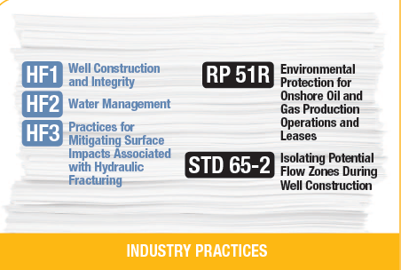
Les Deman Energy Consulting - http://www.lesdemanenergy.com/
Solution: Best Practices and Green Completions
Groundwater Contamination - Include drilling under Safe Drinking Water Act.
Earthquakes – No reports of injury or damage
Air Pollution – Capture escaping gas and volatile organic compounds.
Chemical Contamination – Use best practices in well construction
High Water Usage – Reuse fracking fluids and Inject filtered waste water
Landowner Issues - Protect surface and restore the land to its original contours
Source: American Petroleum Institute: Shale Answers
Notes:
Basic gas production schematic:
1. Gas flows from gas wells (Non Associated gas)
2. And oil wells (Associated Gas)
THE TOTAL OF THESE TWO IS CALLED GROSS GAS WITHDRAWALS
Then some gas is reinjected for pressure maintenance in oil wells and some is flared.
Non hydro carbon gases are removed -- helium, hydrogen sulfide, and nitrogen. WHAT IS LEFT IS CALLED MARKETED PRODUCTION,
Then the remainder is fractionated to remove heavier gases—ethane, propane butanes and natural gasoline. This is required to make gas “pipeline quality.”
WHAT IS LEFT IS CALLED DRY GAS.

Slide 10
Les Deman Energy Consulting - http://www.lesdemanenergy.com/
Shale Gas and Oil Will Reap Long Term Benefits
Reliable and affordable energy
Millions of new jobs in energy intensive industries
Generate billions of tax dollars
Reduced emissions
Notes:
Basic gas production schematic:
1. Gas flows from gas wells (Non Associated gas)
2. And oil wells (Associated Gas)
THE TOTAL OF THESE TWO IS CALLED GROSS GAS WITHDRAWALS
Then some gas is reinjected for pressure maintenance in oil wells and some is flared.
Non hydro carbon gases are removed -- helium, hydrogen sulfide, and nitrogen. WHAT IS LEFT IS CALLED MARKETED PRODUCTION,
Then the remainder is fractionated to remove heavier gases—ethane, propane butanes and natural gasoline. This is required to make gas “pipeline quality.”
WHAT IS LEFT IS CALLED DRY GAS.

Slide 11
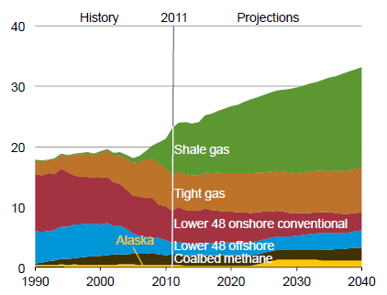
Les Deman Energy Consulting - http://www.lesdemanenergy.com/
Gas for Power Generation, Industry, Exports,….
Source: Energy Information Administration, Annual energy Outlook 2013
Notes:
Most of the increase occurred after 2008, as technology in Shale Gas extraction improved – horizontal drilling a fracking. This Shale Gas revolution turned a tight market into an overflowing market.
The shale plays were basically non associated—no oil, but some other NGLs
Until lately, associated gas production remained virtually flat.—MORE LATER

Slide 12
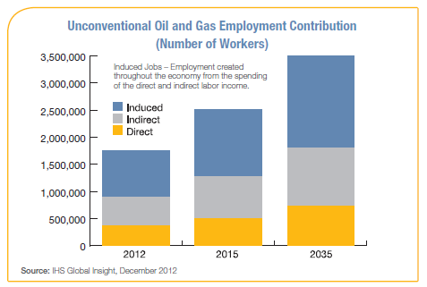
Les Deman Energy Consulting - http://www.lesdemanenergy.com/
Job Opportunities
Source: : American Petroleum Institute: Shale Answers
Notes:
Basic gas production schematic:
1. Gas flows from gas wells (Non Associated gas)
2. And oil wells (Associated Gas)
THE TOTAL OF THESE TWO IS CALLED GROSS GAS WITHDRAWALS
Then some gas is reinjected for pressure maintenance in oil wells and some is flared.
Non hydro carbon gases are removed -- helium, hydrogen sulfide, and nitrogen. WHAT IS LEFT IS CALLED MARKETED PRODUCTION,
Then the remainder is fractionated to remove heavier gases—ethane, propane butanes and natural gasoline. This is required to make gas “pipeline quality.”
WHAT IS LEFT IS CALLED DRY GAS.

Slide 13
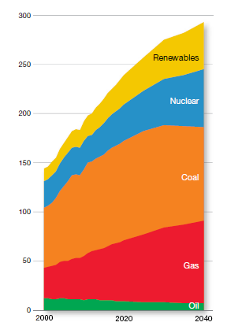
Les Deman Energy Consulting - http://www.lesdemanenergy.com/
Global Benefits of Substituting Gas for Coal
Fuels into Electricity Generation – Quadrillion Btu
Source: ExxonMobil The Outlook for Energy: a View to 2040, 2013
Notes:
Basic gas production schematic:
1. Gas flows from gas wells (Non Associated gas)
2. And oil wells (Associated Gas)
THE TOTAL OF THESE TWO IS CALLED GROSS GAS WITHDRAWALS
Then some gas is reinjected for pressure maintenance in oil wells and some is flared.
Non hydro carbon gases are removed -- helium, hydrogen sulfide, and nitrogen. WHAT IS LEFT IS CALLED MARKETED PRODUCTION,
Then the remainder is fractionated to remove heavier gases—ethane, propane butanes and natural gasoline. This is required to make gas “pipeline quality.”
WHAT IS LEFT IS CALLED DRY GAS.

Slide 14
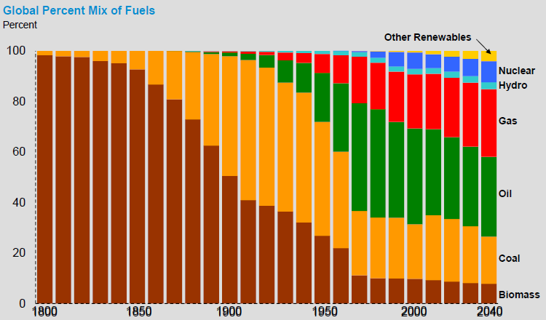
Les Deman Energy Consulting - http://www.lesdemanenergy.com/
Gas Growth = Shrinking Share of Dirty Fuels
Source: ExxonMobil The Outlook for Energy: a View to 2040, 2013
Notes:
Most of the increase occurred after 2008, as technology in Shale Gas extraction improved – horizontal drilling a fracking. This Shale Gas revolution turned a tight market into an overflowing market.
The shale plays were basically non associated—no oil, but some other NGLs
Until lately, associated gas production remained virtually flat.—MORE LATER

Slide 15
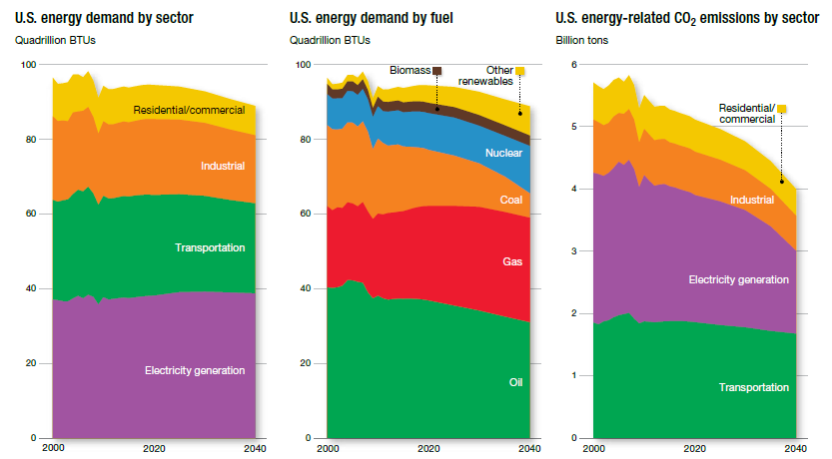
Les Deman Energy Consulting - http://www.lesdemanenergy.com/
Growth in Gas Shale Output = Less Emissions in all Sectors
Source: ExxonMobil The Outlook for Energy: a View to 2040, 2013
Notes:
Most of the increase occurred after 2008, as technology in Shale Gas extraction improved – horizontal drilling a fracking. This Shale Gas revolution turned a tight market into an overflowing market.
The shale plays were basically non associated—no oil, but some other NGLs
Until lately, associated gas production remained virtually flat.—MORE LATER

Slide 16
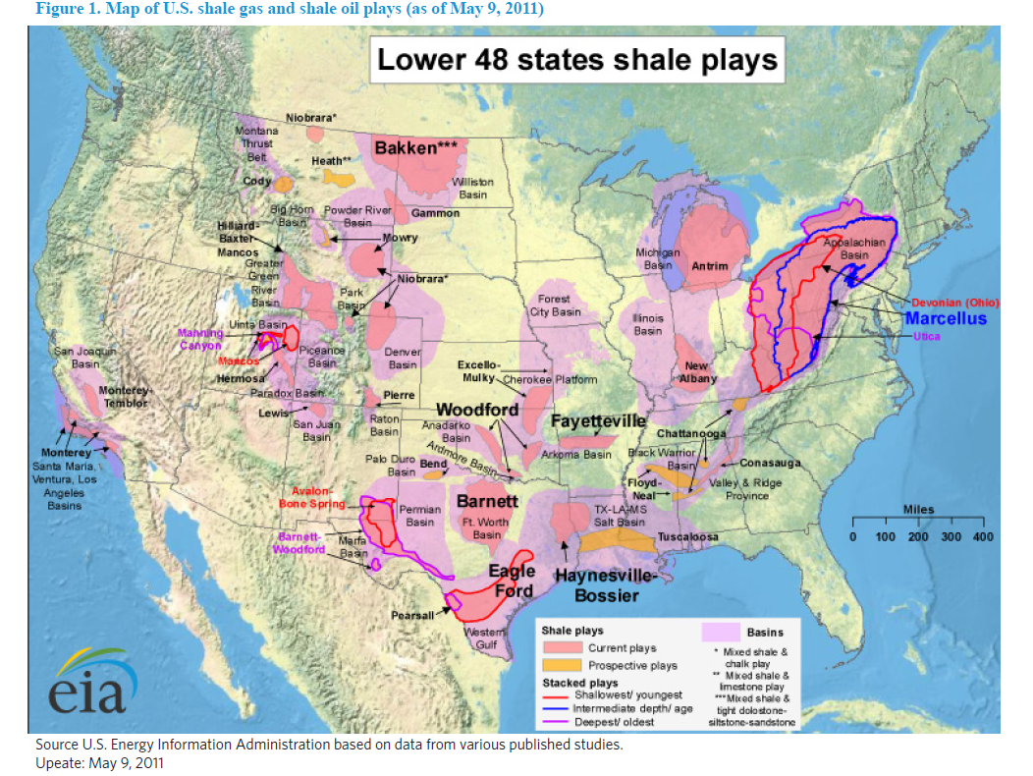
Les Deman Energy Consulting - http://www.lesdemanenergy.com/
Will California Benefit from Shale Gas and Oil?
Notes:
Key oil shale plays include the Bakken & Eagle Ford; rest of the Williston basin; the Monterrey Basin; and Avalon and Boone Springs;

Slide 17
Les Deman Energy Consulting - http://www.lesdemanenergy.com/
RESOURCES
American Security Project, the Geopolitical Implications of U.S. Natural Gas Exports, March 2013
American Petroleum Institute: Gas Answers
Breakthrough Institute Energy & Climate Program, Where the Shale Gas Revolution came From, May 2012
Chevron, Responsible Gas Development, May 2012
Energy Information Administration, Annual energy Outlook, 2013
Energy Information Administration, What is shale gas and why is it important?, 2012
Energy Policy Forum, Shale and Wall Street: Was the Decline in Natural Gas Prices Orchestrated, February 2013.
Energy tomorrow Blog, Mark Green, Tale of Three Shale States, April 2013
ExxonMobil, The Outlook for Energy: A View to 2040, 2013
Global Research, F. Willial Engdahl, The Fracked-up USA Shale Gas Bubble, March 2013
Ground Water Protection Council and All Consultants, Modern Shale Gas Development in the United States: A Primer, 2009
International Energy Agency, World Energy Outlook 2012; November 2012
Wall Street Journal, “Reversal, Neighbors Squeeze Russia over Natural Gas Prices”, May 1, 2013
Wall Street Journal, Joel Kotkin, America’s Red State Growth corridors, February 2013

