Slide 1
U.S. LNG Exports –
Prospects and Implications
W. David Montgomery
Senior Vice President
NERA Economic Consulting
PANC 2013 Annual Seminar
May 21, 2013
The City Club
San Francisco, CA

Slide 2
Major Conclusions of NERA Study on LNG Exports
LNG exports would provide a small but positive net economic benefit
Why is net benefit positive in all scenarios?
  Trade benefits outweigh costs of increased prices and demand reduction
  Fears of runaway exports and prices are unfounded
Why is it small?
  Exports are limited by global competition among LNG suppliers and buyer resistance to higher prices
  U.S. exporters will net a much lower price than seen in importing countries

Slide 3
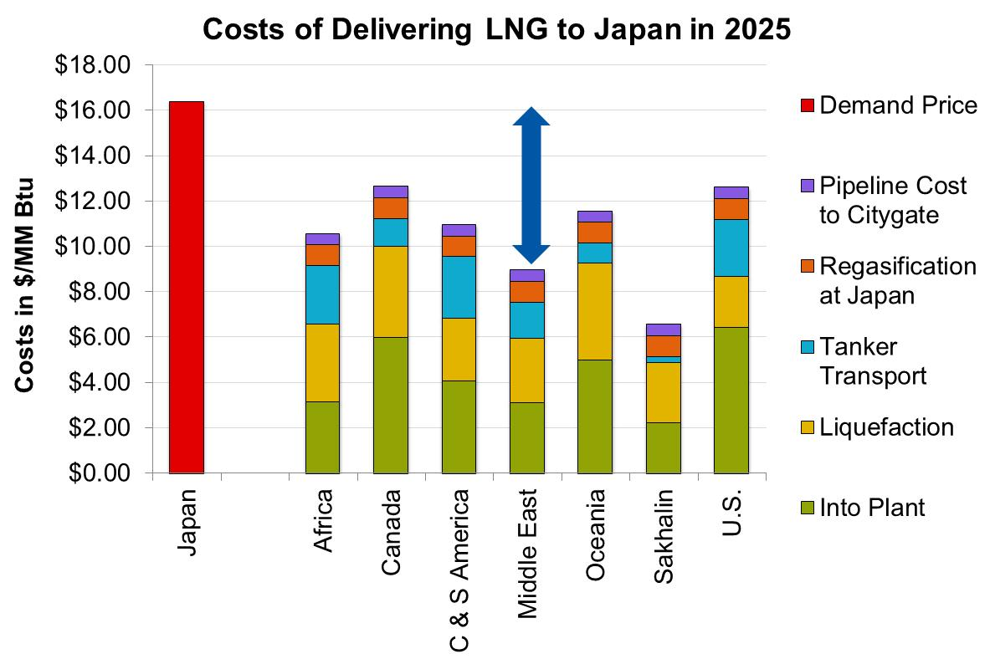
Natural Gas Price Increases Would Be Limited By Global Markets
Global market response limits how high U.S. natural gas prices could rise, even with unlimited exports
  If North American wellhead prices are bid too high, landed cost of North American exports will become uncompetitive with other low cost and more advantageously located suppliers
Natural gas price changes attributable to LNG exports remain in a relatively narrow range across all scenarios:
  Increases less than $1/Mcf likely
  No chance that U.S. prices will approach Asian levels
  Based on current market assessments, price impacts would be smaller
Notes:
This slide shows representative costs for various LNG supply sources selling LNG into the Japanese market.
Show potential profit that is motivating exporters
How long is it sustainable with all these competitors
Relative cost advantage – liquefaction cost low because of in place facilities – but not forever – and transport and gas costs relatively high
The difference between the cumulative costs and the landed price is the profit.
An important issue today is who keeps the profit and important question for tomorrow is will that profit continue to exist or will it be bid away.
Long term perspective, increasing NA prices over the life of these projects

Slide 4
Natural Gas Price Impacts
2011 High EUR Case Approximates 2013 Reference
Wellhead Price vs. Export Levels in 2025
US 2011 Reference
Demand Shock
US 2011High EUR

Slide 5
What Difference Will LNG Exports Make to Fuel Procurement?
Not much
  Low U.S. natural gas costs are required to make exports likely, so that LNG exports more likely to prop up low prices than drive high prices higher
  Price increases due to U.S. gas demand shocks moderated by ability to bid gas away from exporters
  Exports are likely to be capacity limited for some time, insulating U.S. from global market shocks
  Current outlook implies more exports, smaller price impacts
Normal hedging can cover price risks due to LNG exports just as well as normal price risks
  Export growth can be anticipated and will be unlikely to exceed normal demand variability
  Price impacts of exports smaller than other forecast uncertainty

Slide 6
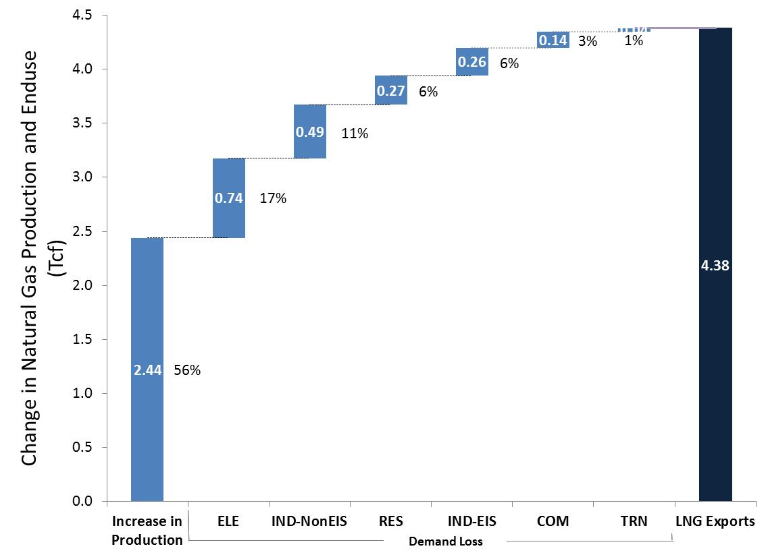
Most LNG Exports Will Come From Increased Supply
Make-up of LNG Exports in 2035

Slide 7
DOE Granted Freeport LNG Export License on May 17, 2013
DOE/FE Order 3282
  Freeport will supply mainly Japanese customers under tolling agreement
  Accepted NERA findings on net benefits, lack of demonstrated harm to manufacturing, likely reduction of price volatility, and magnitude of price impacts
Affirmed policy positions on market choice, preference for free trade, agency for exporters, and that net benefits matter
  Range of factors when reviewing include economic impacts, international impacts, security of natural gas supply, and environmental impacts, among others
  Precedent of prior decisions based on principles of 1984 Policy Guidelines to “minimize federal control and involvement in energy markets and to promote a balanced and mixed energy resource system”
No general policy statement on approvals, will re-examine public interest based on future market conditions and cumulative exports

