Slide 1

Trade association started in March 1998
Promotes trading of power and ancillary products throughout the Western States
Currently 78 members
www.wptf.org
Disclaimer: Opinions expressed by me are my own and do not reflect the views of any other person or organization.

Slide 2
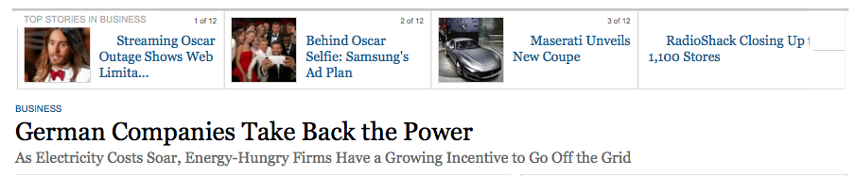
WSJ March 2, 2014
Rapid increase in industrial and commercial customer self-generation to reduce electricity costs that include a 22% adder for the renewable feed-in tariff

Slide 3
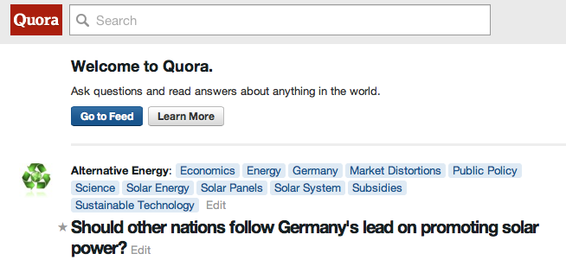
Blog Article and Dialogue
Detailed examination of Germany’s renewable energy policy and why it isn’t working out as planned

Slide 4
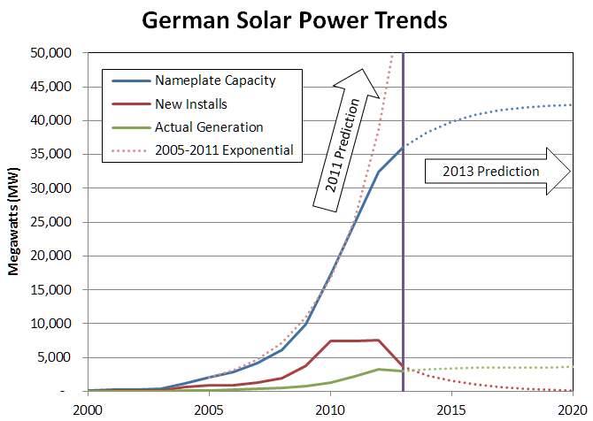
Quora Blog on Germany’s Energy Policy
The dream and the reality are far apart

Slide 5
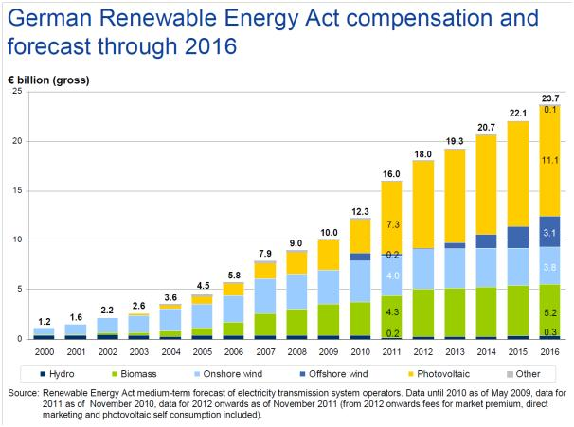
THE LAW OF UNINTENDED CONSEQUENCES
NARUC February 2014 Winter Meeting Electricity Committee
by
Jeffrey Altman

Slide 6
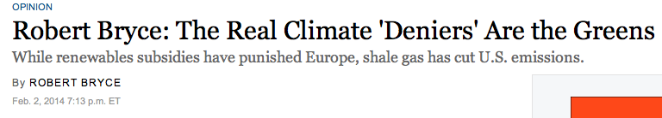
A Conservative Opinion
Germany and Spain, however, despite their ambitious programs and subsidies are headed in the other direction. “Spain has racked up some $35 billion in debt—known as the ‘tariff deficit’—thanks to excessive renewable- energy subsidies. In Germany, renewable-energy subsidies are now costing German consumers and industry about $32 billion a year.” That speaks to the cost. How about GHG emissions? “Even though Germany has spent more than $100 billion subsidizing renewables since 2000, the country's coal use is rising, as are its carbon-dioxide emissions, according to the BP Statistical Review. And Germany's coal use may continue to grow as the country turns away from nuclear power.”

Slide 7
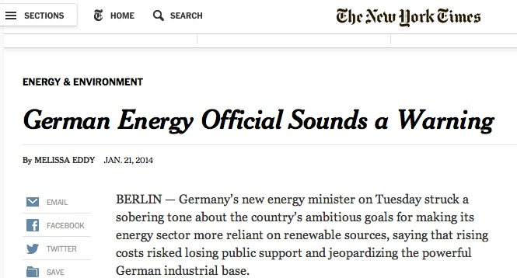
NEW YORK TIMES JANUARY 21, 2014
If that doesn’t convince you, then maybe this observation will: “Conventional energy providers have suffered devastating losses because of imbalances in the energy market caused by the heavily subsidized renewables. Several have demanded that the government compensate them for keeping unprofitable plants active in order to ensure stability on the market.” Yes, very familiar. And the upshot of Germany’s experiment?: “Germany is already the world’s largest miner of brown coal, and last year it produced more electricity from brown coal than any time since 1990.”

Slide 8
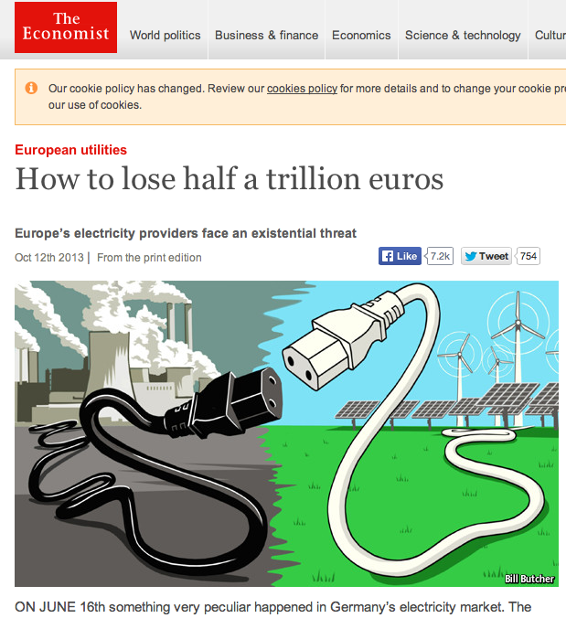
The Economist October 12 2013
The market valuation of Germany’s generating companies has been cut in ½ due to the rapid decline in wholesale energy prices.

Slide 9
My Op Ed on the Economist Article
The story line has been repeated enough … Basically, wholesale electricity prices take a depressing down-swing when solar and wind resources produce energy, reducing the margins for the thermal fleet owned and operated by the European utilities, cutting the utilities’ asset valuation and equity prices, reducing the utilities’ ability to attract capital and invest, causing even relatively new thermal power plants to be mothballed because the economics of continued operation are a clear money loser. The ancillary damages include reduced dividends to pension funds that historically sought stable returns from this sector. So the damage is not limited to the European utilities but a large class of investors as well.

Slide 10
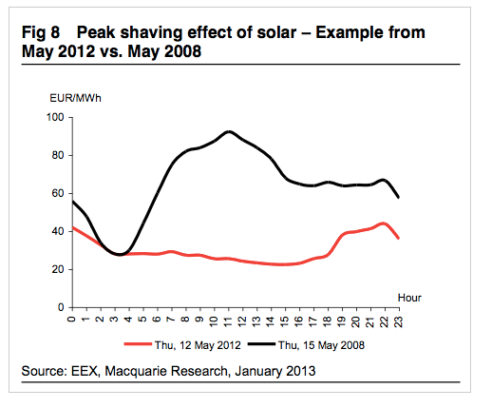
Macquarie Research January 2013
I wrote: “Is it possible that the People’s Republic of California will be out-bungled by the German utility system? There’s just not enough time in a day to dwell upon the many different ways our politically-driven electricity policies can implode, but Germany may give us a window into what’s in store.”

Slide 11
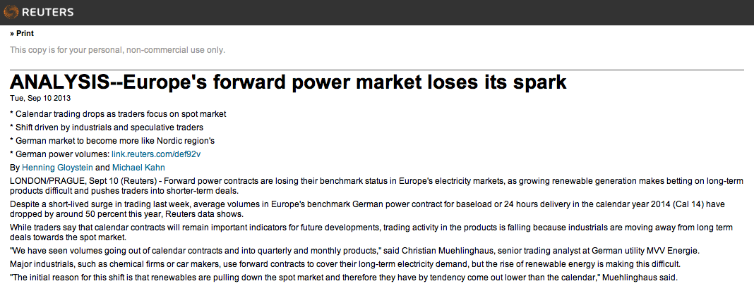
Reuters September 12, 2013
My take: “More volatile yet lower average power prices in California will extend their reach throughout the western states and reduce long-term contract volumes. How does one accurately assess the value of conventional generating capacity in a world like this where the money is going more and more toward the delivery time and less and less towards long-term investment?
“It’s a puzzlement.”

Slide 12
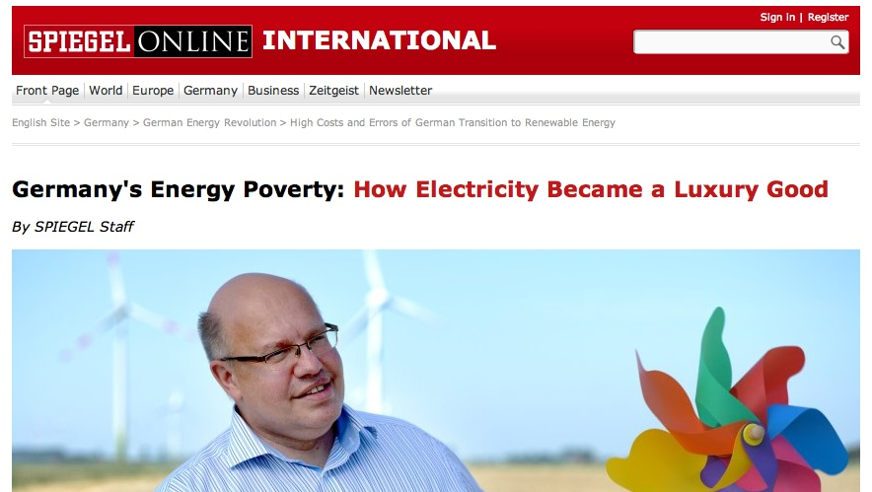
Der Spiegel September 4, 2013
Spiegel said: “Occasionally, Germany has to pay fees to dump already subsidized green energy, creating what experts refer to as ‘negative electricity prices.’
“On the other hand, when the wind suddenly stops blowing, and in particular during the cold season, supply becomes scarce. That's when heavy oil and coal power plants have to be fired up to close the gap, which is why Germany's energy producers in 2012 actually released more climate-damaging carbon dioxide into the atmosphere than in 2011.”

Slide 13
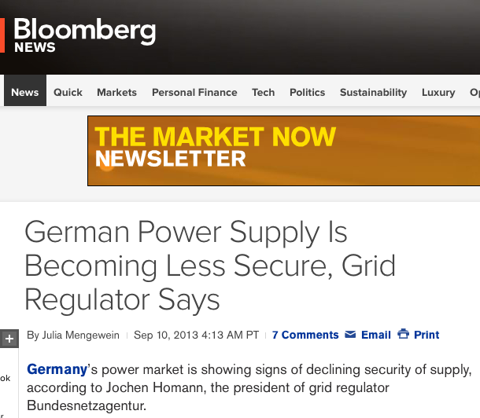
Bloomberg News September 10, 2013
Bloomberg said: “Germany boosted its share of power supply from renewable energy sources such as wind and solar to 23 percent last year from 17 percent in 2010 as Chancellor Angela Merkel’s government seeks to shut all nuclear reactors by 2022.” The result: “The nation’s four grid operators, especially Tennet TSO GmbH and 50Hertz Transmission GmbH, needed to intervene to stabilize the grids during 7,200 hours last year, compared with 1,800 hours in 2010.”

Slide 14
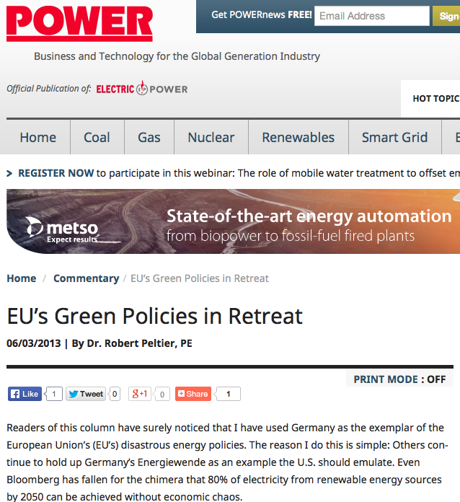
POWER Magazine Editorial June 3, 2013
“Ordinary families are seeing their energy bills rise because they pay the majority of cost of Germany’s lucrative feed-in-tariffs—the industrial side of the economy pays virtually nothing toward integrating renewables. Yet industrial firms are making tracks out of Germany and other EU countries anyway, often to the U.S., where energy prices are relatively low.”

Slide 15
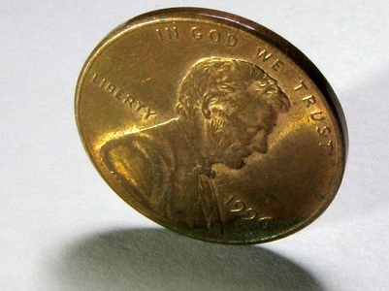
State Energy Policy Outcome has Become a Flip of a C oin
Harry Callahan: “You've gotta ask yourself a question: "Do I feel lucky?" Well, do ya, punk?”

Slide 16
Off Ramps and Saviors (?)
EIM
Diverse renewable portfolio
OTC licenses extended
Diablo Canyon doesn’t retire in 2024
EPA rules and CARB regional linkages

