Slide 1
Perspectives on Resource Adequacy
Matt Barmack
Director, Market & Regulatory Analysis
Calpine Corp.

Slide 2
Overview
What is RA?
What is wrong with RA?
Potential changes to the RA market

Slide 3
What is RA?
An obligation on load-serving entities to secure sufficient capacity on a forward basis to satisfy reliability requirements
  System level PRM
  Local Capacity Requirements
  Flexible Capacity Requirements
Current obligations are year- and month-ahead
RA capacity in California is procured bilaterally
  RA-only transactions
  Bundled with other products
    UOG
    DR
    Tolling agreements
    RPS
  CPM

Slide 4
What is wrong with RA?
Combination of RA with other market opportunities may not provide sufficiently high and predictable revenue for merchant conventional generators to make rational decisions about retirement, maintenance, and upgrades

Slide 5
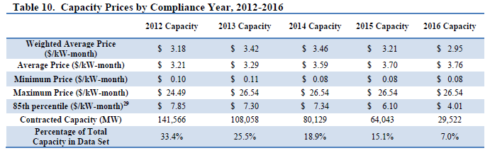
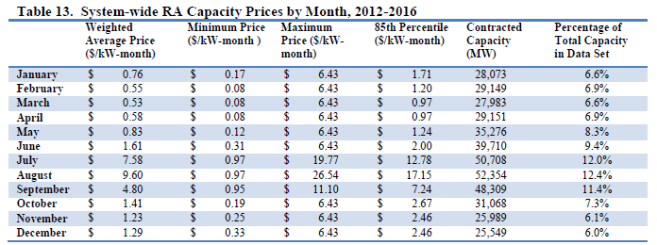
RA pricing
Notes:
http://www.cpuc.ca.gov/NR/rdonlyres/94E0D083-C122-4C43-A2D2-B122D7D48DDD/0/2012RAReportFinal.pdf
1 year strip at average prices yields about $31/kW-year.

Slide 6
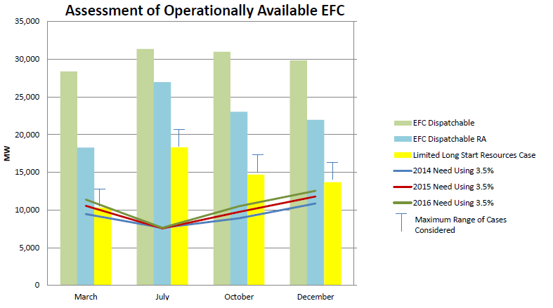
Will flexible RA yield additional compensation?
Notes:
http://www.caiso.com/Documents/FlexRAPresentation_%20CPUC_Workshop03-20-2013FinalUpdated20PercentTracking.pdf

Slide 7
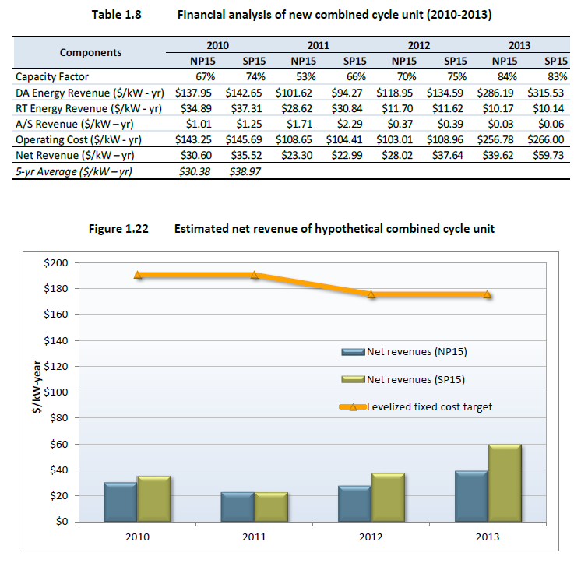
Energy and AS compensation
Notes:
http://www.caiso.com/Documents/2013AnnualReport-MarketIssue-Performance.pdf

Slide 8
Existing CCGTs could be low cost renewable integration resources

Slide 9
System RA is not as-long as it seems
Notes:
Start with ED trajectory scenario.
Assume all incremental renewables are PV.
Reduce solar NQC by 2/3.
Assume that half of current supply-side DR doesn’t count for RA after bifurcation.
Discount all AA-EE.

Slide 10
Policies that impact RA
Potential solutions
  There is no problem. Existing gas plants are either (a) not at risk of retirement or (b) not needed
  Extend RA requirements forward, e.g., three years
    More forward revenue certainty (e.g., 1 year of certainty, 3 years forward)
    More incentives for LSEs to contract forward (Potentially multiple years of revenue certainty)—especially for non-IOU LSEs
  More forward contracting of existing resources by IOUs (and other LSEs)
  Implement a centrally cleared market with a demand curve
    Buy more at decreasing prices when the market is over-supplied
    Not all capacity needs to flow through the market in order for the market to influence pricing
  Stop over-counting renewables (ELCC)
  Stop over-counting DR

