Slide 1

Rationale for Energy Storage Procurement Targets
How Energy Storage Can be Cost Effective and Help Optimize the Grid
Janice Lin
Co-Founder & Executive Director, CESA
Managing Partner, Strategen Consulting
December 17, 2013

Slide 2















Strategen
Strategic thinking and industry expertise creates profitable clean energy businesses
A sampling of our clients:
U.S. Department of Energy
Notes:
1

Slide 3























































CESA – Strength Through Diversity & Collaboration
Steering Committee
General Members

Slide 4
California’s Electric System Is Not Being Efficiently Utilized
California Load
The current electric system must have enough transmission, distribution, generation capacity for the largest annual peak load
Weekly average load
Most of the year, the system is operating at about 55% of peak
Data Source: CAISO 2011 OASIS Data – Graph is for illustration purposes only.

Slide 5
Storage lets us utilize the system assets we have more efficiently
During peak times, storage helps to reduce overall load, reducing the need for excess generation capacity
With storage, we can better utilize existing grid resources during off-peak times
Data Source: CAISO OASIS Data – Graph is for demonstration purposes only.

Slide 6
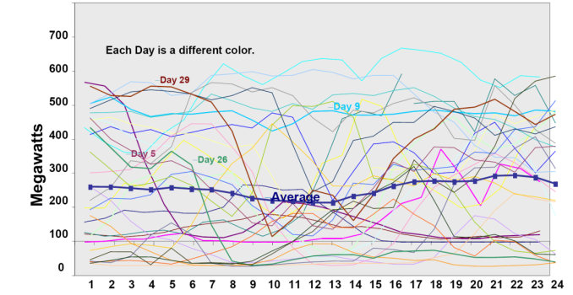
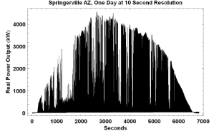
Storage can be used to smooth minute to minute fluctuations
One Month’s Power
from a Wind Farm³
Typical diurnal
hourly load profile¹
Springerville, AZ
One Day at 10 Second Resolution ²
Minute to minute fluctuations from load or supply
Hour of Day
Source: CAISO 2007 Summer Loads and Resources Operations Assessment March 8, 2007
Source: Integration of Renewable Resources, CAISO Report, November 2007
Source: Jay Apt and Aimee Curtright, Carnegie Mellon Electricity Industry Center working Paper CEIC-08-04

Slide 7
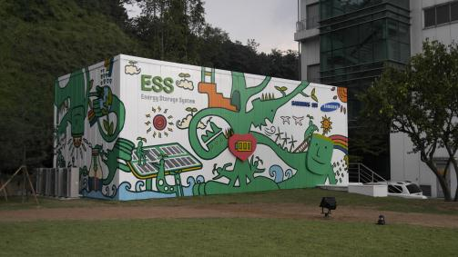
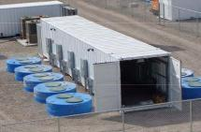
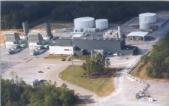
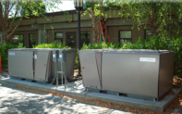
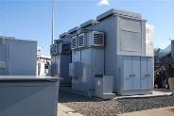
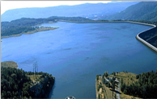
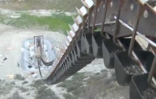
Energy Storage Is A Very Broad Asset Class
Chemical Storage
Mechanical Storage
Bulk Mechanical Storage
(Batteries)
(Flywheel)
(Compressed Air)
Thermal Storage
Bulk Gravitational Storage
(Ice)
(Molten Salt)
(Pumped Hydro)
(Gravel)
Notes:
Broad asset class
Lots already installed! Approx 200+ GW globally
Includes
135 GW pumped hydro
64 GW UPS – emergency backup
2-3 GW of grid storage (various types) shown above

Slide 8
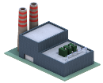























Diversity & Modularity = Broad Electric Power System Applicability
Bulk Storage
Ancillary Services
Distributed
Storage
Distributed
Storage
Commercial
Storage
Residential
Storage

Slide 9
Some Energy Storage is Already Installed On the Grid
Estimated Global Installed Capacity of Energy Storage (MW)
Represents approximately 2.7% of Global Installed Electric Capacity¹
Non-Pumped Hydro: 2,328 MW
Global Total (Excl. UPS): 140,101 MW
¹Based on EIA 2010 Total Electricity Installed Capacity Data (http://www.eia.gov/cfapps/ipdbproject/IEDIndex3.cfm?tid=2&pid=2&aid=7)
* Batteries include Flow, Lithium Ion, Sodium Sulfur, Nickel Cadmium, Lead Acid, and Ultra Batteries
Source: Based on DOE International Energy Storage Database (http://www.energystorageexchange.org) Est are current as of December 2013

Slide 10
Worldwide Energy Storage by Country
Source: Based on DOE International Energy Storage Database (http://www.energystorageexchange.org) Est are current as of December 2013

Slide 11
AB 2514 Overview – A Unique Mandate for California
Cost-Effectiveness is a REQUIREMENT Under AB 2514
Required the Commission to open a proceeding to determine appropriate targets, if any, for each load-serving entity to procure viable and cost-effective energy storage systems.
By October 1, 2013, to adopt an energy storage procurement target, if determined to be appropriate, to be achieved by each LSE by December 31, 2015, and a 2nd target to be achieved by December 31, 2020.
The California Public Utilities Commission (CPUC) shall reevaluate the determinations made pursuant to this subdivision not less than once every three years.
CPUC must consider a variety of possible policies to encourage the cost-effective deployment of energy storage systems, including refinement of existing procurement methods to properly value energy storage systems.
Notes:
Annual utilization
Range
Speed of response – (show FR graph)

Slide 12
Historic Assigned Commissioner’s Ruling: 1.325 GW Goal!

Slide 13
AB 2514 Implementation Process and Timeline
Set Cost-Effectiveness Methodology
Complete Cost Effectiveness Evaluation
Revise Recommendations
2013
Jan.
Feb.
Mar.
Apr.
May
June
July
August
Sept.
Oct.
Nov.
Dec.
Conduct Cost-Effectiveness Evaluation of Key Applications
Final Decision implementing recommendations
Propose procurement recommendations
October 1, 2014
POU Compliance Deadline
2014
Jan.
Feb.
Mar.
Apr.
May
June
July
August
Sept.
Oct.
Nov.
Dec.
March 1, 2014
Deadline for IOUs to file procurement application
December 1, 2014
First round of solicitations
Notes:
Set Cost-Effectiveness Methodology
Stakeholders and Commission decide on which methodology is most appropriate for each application (example: KEMA model for peakers).
Conduct Cost-Effectiveness Evaluation of Each Application Category
Commission and stakeholders conduct cost-effectiveness analysis.
Set Targets
All application Categories that prove to be cost-effective proceed to discussion and analysis of procurement targets.
Pilot Evaluation
Application categories that do not pass the cost-effectiveness threshold are evaluated for potential pilot procurement based on key criteria such as market transformation, changing market dynamics that will affect future cost-effectiveness, and as yet unforeseen value to California.
Commission issues Proposed Decision outlining procurement recommendations
Commission adopts procurement recommendations based upon the results of cost effectiveness

Slide 14
If Cost-Effective, Why is a Target Necessary?
Importance of a Clear Market Signal
Encourage investment and more rapid cost reduction, especially in the value chain components (balance of plant, design, installation, commissioning, maintenance)
Focus related policy work to streamline procurement processes and realize benefits sooner
Help focus and coordinate various procurement groups within utilities to quantify and realize benefits of storage sooner
Provide consistent framework for infrastructure and policy development.
Motivate utilities to embrace fundamental change (similar to effect of RPS for renewable energy)
Notes:
Annual utilization
Range
Speed of response – (show FR graph)

Slide 15

Storage is Now Part of Ongoing Procurement
CPUC Decision Approves $26M in SDG&E’s 2012 General Rate Case
May 9, 2013
$26 million for distributed storage/grid reliability
$4.8 million per year ($19 million total) for additional RD&D projects including energy storage
Procurement to occur immediately and over next few years

Slide 16
Storage Will Soon Be Part of Long Term Procurement
CPUC Decision requires 50MW of energy storage for local capacity requirements
February 13, 2013
“Southern California Edison (SCE) to procure… at least 50 MW [of] energy storage resources, [and] up to an additional total of 600MW of capacity required to be procured from preferred resources - including energy storage resources.”
Energy storage resources must be considered “along with preferred resources” including energy efficiency, demand response and distributed generation, consistent with… California’s Energy Action Plan.”

Slide 17

Governor’s Executive Order: 1,500,000 EVs by 2025
Infrastructure is Needed for:
1,000,000 EVs by 2020
1,500,000 EVs by 2025

Slide 18
CESA Uniquely Addresses the Role of EVs and EV Charging on the Grid
 | Focus |  |  | Services
 |  |  |  | Advocacy
 | Electric Vehicles | Vehicle-Grid Integration | EV Business Models | CEC | CPUC | CAISO | FERC | MTC | General | Education & Outreach | Research | Tech. Standards Dev.
CESA EV Working Group | ☑ | ☑ | ☑ | ☑ | ☑ | ☑ | ☑ | ☑ | ☑ | ☑
Joint Electric Vehicle Service Providers | ☑ |  |  |  |  |  |  |  | ☑
California Plug-In Electric Vehicle Collaborative | ☑ |  |  |  |  |  |  |  |  |  | ☑
California Electric Transportation Coalition | ☑ |  |  |  |  |  |  |  | ☑
ANSI Electric Vehicle Standards Panel | ☑ |  |  |  |  |  |  |  | ☑ |  | ☑ | ☑
Society of Automotive Engineers | ☑ |  |  |  |  |  |  |  |  | ☑
PlugIn America | ☑ |  |  |  |  |  |  |  |  | ☑
CALSTART | ☑ |  |  |  |  |  |  |  | ☑ | ☑
Limited participation

Slide 19
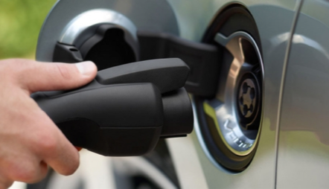

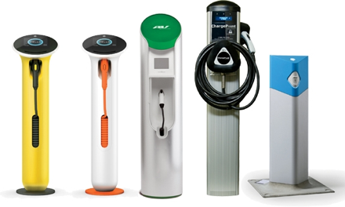


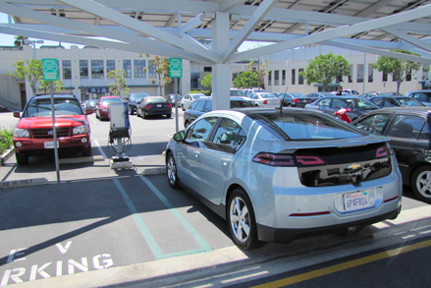

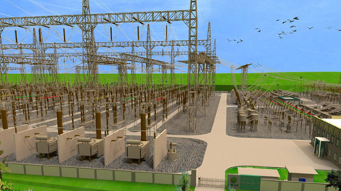

Coalition-Building is Key: Finding Win-Win Solutions
EV Owners
Charging Infrastructure/Service Providers
Facilities Management
Utilities

Slide 20
Supporting EV Deployment is Already a Core Part of CESA
Electric Vehicles
DG Interconnection OIR
FERC – Federal Energy Regulatory Commission
LTPP/RA – Long Term Procurement Planning/Resources Adequacy
PLS – Permanent Loading Shifting
SGIP – Self-Generation Incentive Program
Storage Rulemaking (AB2514 implementation)
RPS – Renewable Portfolio Standard
CAISO – California Independent System Operator
CPUC AFV OIR – the main forum for EV Ecosystem development!
CESA will ensure that distributed aggregated EV’s and EV chargers can participate in CAISO’s ancillary services markets
CESA will ensure fair and transparent interconnection protocols for energy storage, including Evs and EV charging
CESA weighs in on relevant FERC orders on behalf of all applications, including Evs and EV Charging
CESA will ensure that Evs and EV Charging can participate in LTPP and new RA/Flexible Capacity opportunities
Incentive program currently applies to thermal storage, but is an interesting template for behind the meter incentives
CESA ensures healthy rules and fair access to incentives, including storage used to augment EV charging
CESA successfully advocated for EVs (V2G) and Storage used for EV charging to be eligible toward meeting LSE procurement targets
EV charging is an excellent renewable integration resource

Slide 21
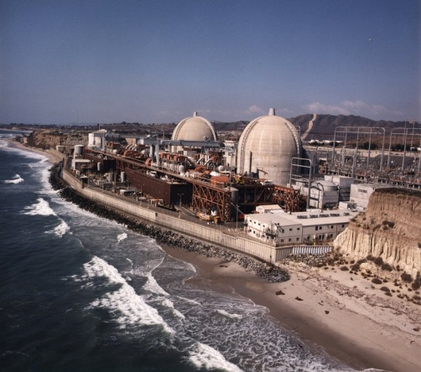
California’s Electric Power System Faces Big Challenges
Many power plants could go offline in the next decade for a variety of reasons
Once-Through Cooling Phase-Out Schedule⁽¹⁾
Plant Name | MW | Scheduled Phase-Out Date
El Segundo, Harbor (LADWP), Morro Bay | 550 | December 31, 2015
Encina, Contra Costa, Pittsburg, Moss Landing | 950 | December 31, 2017
Haynes (LADWP) | 1,581 | December 31, 2019
Huntington Beach, Redondo, Alamitos, Mandalay, Ormond Beach, Scattergood (LADWP) | 888 | December 31, 2020
Diablo Canyon Power Plant | 2,240 | December 31, 2024
San Onofre
San Onofre Nuclear Generation Station (SONGS) has been permanently shut down since January of 2012, taking 2,254MW offline.
(1) Sierra Club Report: “Meeting California’s Electricity Needs Without San Onofre or Diablo Canyon Nuclear Power Plants”. CEC Docket 13-IEP-1D, TN 71790, Jul 29, 2013
Notes:
Annual utilization
Range
Speed of response – (show FR graph)

Slide 22
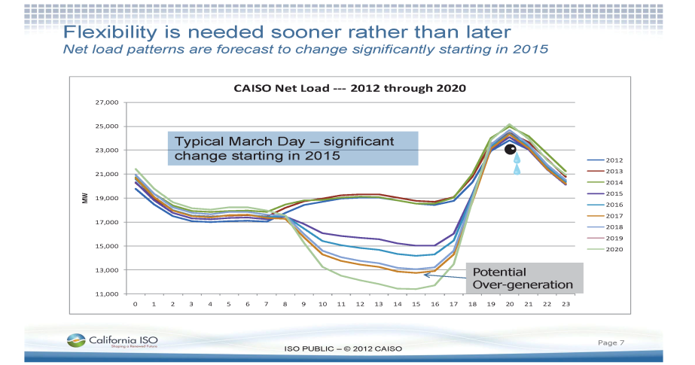
California’s Electric Power System Faces Big Challenges
Planned renewable procurement will drastically affect California’s net load
Notes:
Annual utilization
Range
Speed of response – (show FR graph)

Slide 23
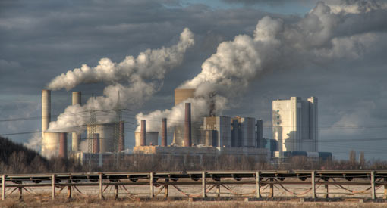
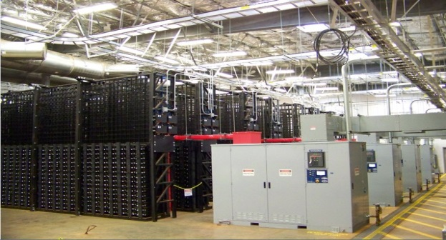
Comparing Energy Storage With The Status Quo
VS.
Natural Gas Peaker
Energy Storage
Key Criteria to Consider
Siting Constraints
Installation Speed
Available Flexible Range
Capacity Factor (hours of operation/year)
Multiple Value Stream Capture
Ramp/Response Rate
Total Emissions
Water Usage
Notes:
Annual utilization
Range
Speed of response – (show FR graph)

Slide 24
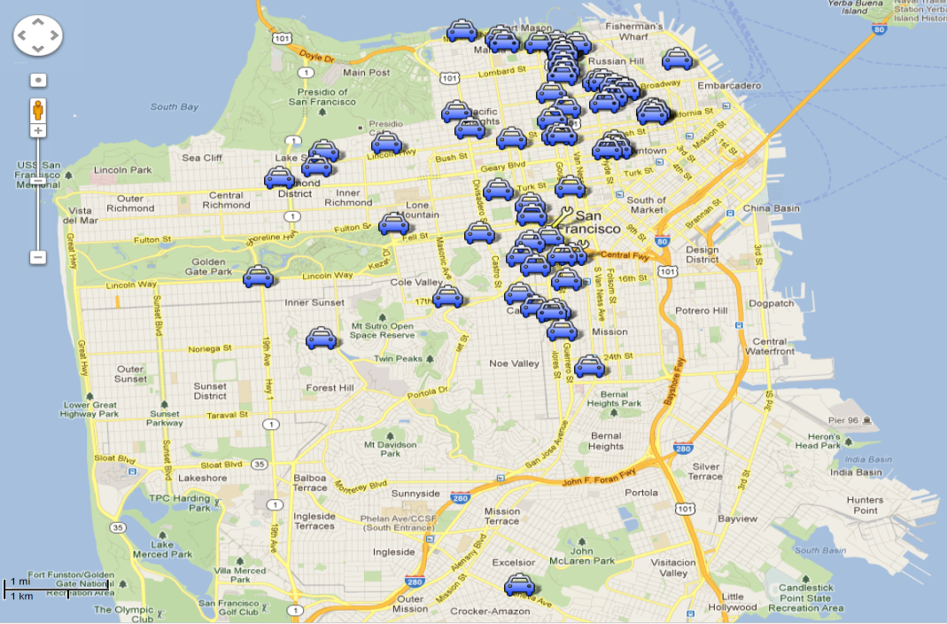

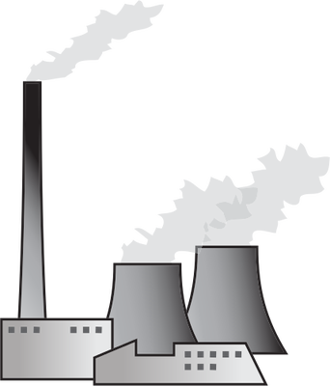
Energy Storage Can Be Sited Closer to the Load
Nearest Power Plant: 20 miles East.
Russell City Energy Center
Hayward, Ca
ES Siting Source: Powertree Integrated Energy Services
Notes:
Annual utilization
Range
Speed of response – (show FR graph)

Slide 25
Energy Storage: Diverse, Modular, Faster to Install!
Battery and thermal storage resources can be installed much more quickly than traditional resources, reducing risk and increasing technology flexibility
Siting, Permitting, and Installation Time by Resource
Notes:
Annual utilization
Range
Speed of response – (show FR graph)

Slide 26
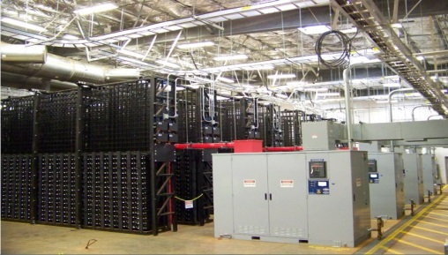
Energy Storage: Four Times the Flexible Range
Important to compare benefits, not megawatts
100MW
Max. Output
50 MW Range
100MW
Discharge
50MW
Min. Output
200MW Range
-100MW
Charge
100MW
LMS 100
Gas Peaker Plant¹
100MW
Energy Storage System
1. Source: http://yosemite.epa.gov/R9/air/EPSS.NSF/e0c49a10c792e06f8825657e007654a3/8a153d8ab24cb6868825723400679b82/$FILE/WCE%20Evaluation.pdf
Notes:
Annual utilization
Range
Speed of response – (show FR graph)

Slide 27
Energy Storage: Three Times the Utilization
Energy storage can be utilized more fully throughout the year
20%-40%
>95%
Utilization
Utilization
100 MW
LMS 100
Gas Peaker Plant¹
100MW
Energy Storage System
1. Source: http://yosemite.epa.gov/R9/air/EPSS.NSF/e0c49a10c792e06f8825657e007654a3/8a153d8ab24cb6868825723400679b82/$FILE/WCE%20Evaluation.pdf
Notes:
Annual utilization
Range
Speed of response – (show FR graph)

Slide 28
Energy Storage Can Capture Multiple Value Streams
Energy storage can be fully utilized throughout the year, providing multiple services from a single asset
% Total Annual Hourly Asset Utilization
Services Provided by Energy Storage Over the Year*
Down Regulation
Up Regulation
Spinning Reserves
Energy
Energy storage is a cost effective way to provide numerous benefits to many stakeholders, few of which can be monetized today.
Graphs based on EPRI cost effectiveness model data, “Bulk Peaker substitution application” CPUC Workshop March 25, 2013
*All services include charging and discharging bids
Notes:
27

Slide 29
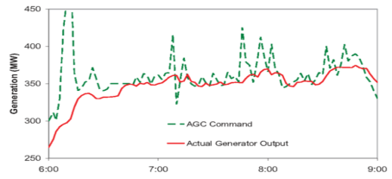
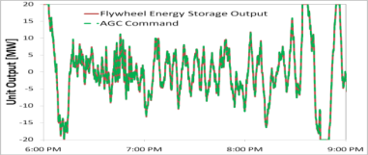
Energy Storage Can Respond Faster and is More Effective
Energy storage responds far more quickly and is more effective
LMS 100 Gas Peaker Plant
Full Power Ramp 10 Minutes
Energy Storage System
Full Power Ramp <1 second
Graph Source: Kirby, B. “Ancillary Services: Technical and Commercial Insights.” Wartsilla, July, 2007. pg. 13
1. http://www.cpvsentinel.com/about.html
Notes:
Annual utilization
Range
Speed of response – (show FR graph)

Slide 30
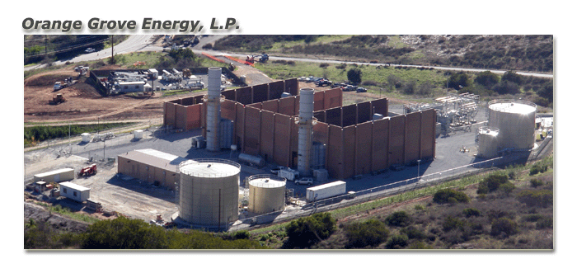
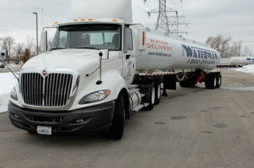
Conventional Peakers are Expensive and Use Tons of Water
J-Power Orange Grove Peaking Plant
100 MW (2 x LM6000)
$174/kW-year in capacity revenue (Source: FERC EQR)
25 year tolling agreement with SDG&E
“Water delivery will require approximately one [6500 gallon] truck per hour for fresh water and one truck per hour for reclaimed water during times when the plant is operational.”¹
1) Source: CEC http://www.energy.ca.gov/2009publications/CEC-800-2009-003/CEC-800-2009-003-CMF.PDF
Notes:
Greenhouse gas (GHG) policy
AB 32 compliance begins in 2012; target: 1990 emissions by 2020
Will increase costs of relying on carbon-emitting thermal plants used for energy regulation and ancillary services

Slide 31
Status Quo: CT Operation at EME Walnut Creek Energy Park
State of the art LMS 100 installations require significant start-up and shutdown operating hours, accounting for at least 20% of operations:
EME Walnut Creek Energy Park SCAQMD Analysis⁽¹⁾
Capacity Factor - min | 20%
Capacity Factor - max | 40%
Operating Hours - Normal | 2768
Operating Hours - Start-up | 350
Operating Hours - Shutdown | 350
Service Factor - Normal | 32%
Service Factor - Total | 40%
Minimum load | 50%
Average load | 75%
Starts/year | 350
Max starts/day | 2
Max start-ups/year | 350
Start-up time (minutes) | 35
Chart of Annual Plant Operation
http://yosemite.epa.gov/R9/air/EPSS.NSF/e0c49a10c792e06f8825657e007654a3/8a153d8ab24cb6868825723400679b82/$FILE/WCE%20Evaluation.pdf

Slide 32
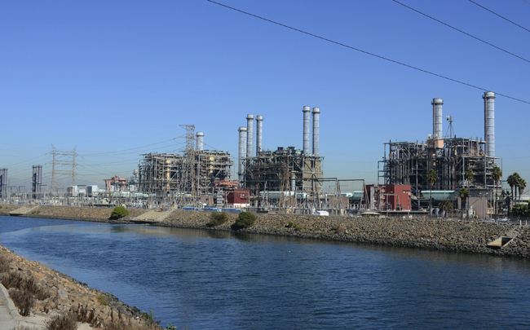
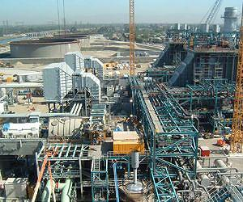
Even Repowered Peakers are Expensive
Repower: Building a new power plant on the same site as an old, decommissioned plant
LADWP Haynes Repower
6 x LMS100
$782M / 577.8 net MW
Cost: $1353/kW¹
Due to repower, cost excludes:
Land aquisition & permitting
New transmission infrastructure
Site access construction
1) Source: http://www.powermag.com/ladwp-harnesses-lms100-to-solve-once-through-cooling-dilemma/
Notes:
Greenhouse gas (GHG) policy
AB 32 compliance begins in 2012; target: 1990 emissions by 2020
Will increase costs of relying on carbon-emitting thermal plants used for energy regulation and ancillary services

Slide 33
Emission Impacts Due to Cycling CCGTs & CTs
NREL concluded that cycling conventional power plants has significant impacts on emissions
CO₂ Emissions Penalties⁽¹⁾
Power Plant Type | Part-Load⁽²⁾ | Ramping⁽³⁾ | Start/Stop
Gas Combined Cycle (CCGT) | 15% | 1% | 30%
Gas Combustion Turbine (CT) | 17% | 1% | 40%
NO_{X} Emissions Penalties⁽¹⁾
Power Plant Type | Part-Load⁽²⁾ | Ramping⁽³⁾ | Start/Stop
Gas Combined Cycle (CC) | 29% | 8% | 610%
Gas Combustion Turbine (CT) | 16% | 1% | 180%
Listed as percentage penalty over the equivalent full‐load operation for one hour
Assumes operation at 50% of capacity
Ramping leads to far less emissions compared to startups, but occurs more often
Source: National Renewable Energy Laboratory (NREL/PR‐6A20‐55828): Impacts of Renewable Generation on Fossil Fuel Unit Cycling: Costs and Emissions (May 20, 2012)

Slide 34
GHG Impacts: Natural Gas = Coal
Recent analysis from the University of Colorado at Boulder and the National Oceanic and Atmospheric Administration (NOAA) indicates that methane leakage at gas production facilities is 4x to 7x higher than previously thought⁽¹⁾
Methane is 25x more potent than C02 as a GHG.
This increased leakage estimate puts natural gas-fired power plants at a break-even point with coal-fired plants’ GHG emissions
Climate Central: http://www.climatecentral.org/news/methane-leaking-in-utah-suggests-higher-national-rate-16316

Slide 35
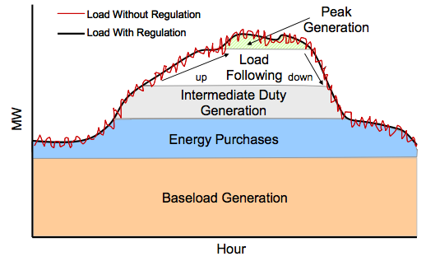
Storage Can Help Optimize Existing Fossil Assets
Build cleaner CCGT’s, let them run at max efficiency
Generation comes on “in order”
Cheaper & cleaner “baseload” is always on
More expensive, dirtier “peakers” turn on in succession.
Let storage be load following
Energy Storage can even cut costs & reduce emissions!
Daily System Energy Demand
$ and CO2
34

Slide 36
Storage Can Help Optimize Existing Fossil Assets
Build cleaner CCGT’s, let them run at max efficiency
Generation comes on “in order”
Cheaper & cleaner “baseload” is always on
More expensive, dirtier “peakers” turn on in succession.
Let storage be load following
Energy Storage can even cut costs & reduce emissions!
Daily System Energy Demand
$ and CO2
Discharge
Charge
35

Slide 37
Advantages of Energy Storage
Procuring Energy Storage NOW Will Offset Need for More Peakers
Easier to site, faster to install (2-3 years vs. 7-8 years from permitting)
Four times the flexible range
Three times the operational hours per year
600x the ramp rate – much faster and more effective response time
No local emissions
Little to no water use
Natural gas plants have 30+ year operating lifetimes. To shape a cleaner, more efficient, and more affordable future electricity system, we need to change our direction NOW. Shifting from peakers to energy storage is a key part of that transition.
Notes:
Annual utilization
Range
Speed of response – (show FR graph)

Slide 38
We Cannot Continue Adding Gas-fired Plants
“….In order to rely on such intermittent sources of renewable-generated power, utilities must have available other, nonrenewable generating resources or significant storage that can fill the gap when renewable generation decreases. Indeed, because of this need for backup generation, or if and when utility-scale storage becomes feasible and cost-effective, nonrenewable generation must increase in order for the state to meet the 20 percent renewable portfolio standard.
…we cannot and should not continue adding gas-fired plants ad infinitum.”
- California Energy Commission
Source: http://www.energy.ca.gov/2009publications/CEC-800-2009-003/CEC-800-2009-003-CMF.PDF

Slide 39
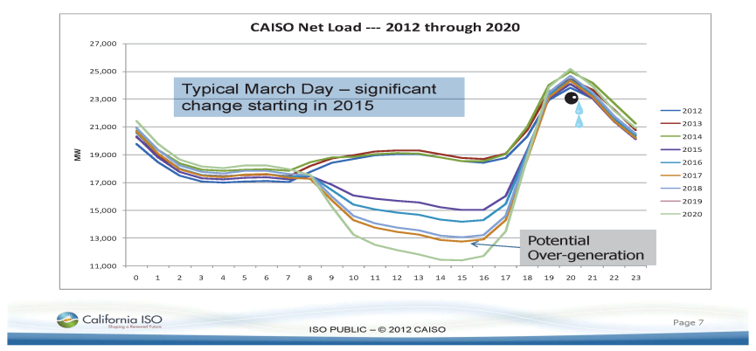
Energy Storage Can Help Address California’s New Net Load

Slide 40
Why Renewable Energy + Energy Storage Is the Future
Upfront Cost of Solar vs. Traditional Generators¹
NEDO/DOE 2010 Li Ion Cost Projections
Key Trends
Industry is tracking DOE & NEDO cost reductions for Li-ion (10X improvement in ten years)
Upfront costs for traditional generators are increasing
Renewable costs are decreasing, reducing the charging costs for energy storage
Source: California Energy Commission
2009 starting dollars, escalated at 2.5% per year

Slide 41
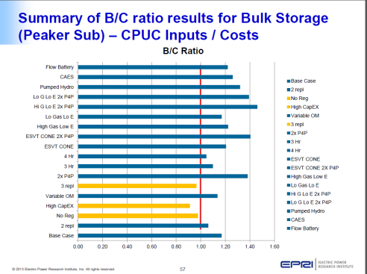
Cost Effectiveness Results: Bulk Peaking Power Plant Use Case
Preliminary results by EPRI using stakeholder input showed a benefit to cost ratio over one for nearly every scenario
Projects were assumed to be utility scale projects starting in 2015 and 2020
Cost effectiveness results did not include GHG benefits of storage or GHG costs due to AB32 implementation
High renewable penetration cases had the highest benefit to cost ratios for storage.
GHG benefits for storage are greater the more renewables we have on the grid.

Slide 42

Summary
Energy storage can provide much greater benefits per MW as a flexible resource!
VS.
100 MW Gas Turbine
10 minute ramp
50 MW flexible range
2768 useable hours/year⁽¹⁾
6500 gallons per hour
Status quo GHG emissions
Energy Storage Benefits
>600x the ramp rate
>4x the flexible range
>3x the operational hours
Less water usage on many sites
Lower GHG emissions
100 MW Energy Storage
<1 second ramp
200 MW of flexible range
>8300 useable hours/year
Little to no water usage
Reduces GHG emissions by up to 90%⁽²⁾
(1)Excluding start-up and shutdown time
(2)http://www.energy.ca.gov/2011_energypolicy/documents/2011-02-15_workshop/comments/California_Energy_Storage_Alliance_03032011_TN-59863.pdf

Slide 43
The Procurement Target Makes Sense for the Grid
The first LMS 100 turbine had only one unit in commercial operation seven years ago.¹
The CPV Sentinel and EME Walnut Creek projects total 1.3 GW. Both projects came online last quarter to serve one California IOU.
1.3 GW of cost-effective energy storage procurement across all three IOUs over the next seven years will provide the best match for grid needs while reducing our long term dependence on gas.
Continued focus on bulk storage is critical: 3 GW of pumped hydro power is already planned (advanced stages of licensing at FERC)
Source: http://www.energycentral.com/generationstorage/fossilandbiomass/news/vpr/2232/GE-s-First-LMS100-Enters-Commercial-Operation-At-South-Dakota-Plant
Notes:
Greenhouse gas (GHG) policy
AB 32 compliance begins in 2012; target: 1990 emissions by 2020
Will increase costs of relying on carbon-emitting thermal plants used for energy regulation and ancillary services

Slide 44
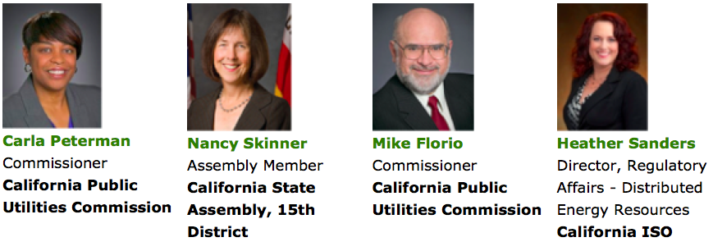
Join the California Energy Storage Alliance (CESA)
Advocacy/Market Development: understand the rules and design the market (AB2514, SGIP, LTPP/RA, etc.).
Business Development: join a network of 70+ members including RE and Storage Developers, Manufacturers, Integrators, Software Providers, and others.
Market & Regulatory Intelligence: access experts and join our monthly policy calls to weigh in on the fast pace policy and market development in California.
Networking, Marketing, and Relationship Building: join CESA events, webinars, and meetings with key executives from leading utilities and regulatory agencies.
JOIN INDUSTRY LEADERS
CESA ANNUAL MARKET DEVELOPMENT FORUM
Jan 14-15, 2014

Slide 45

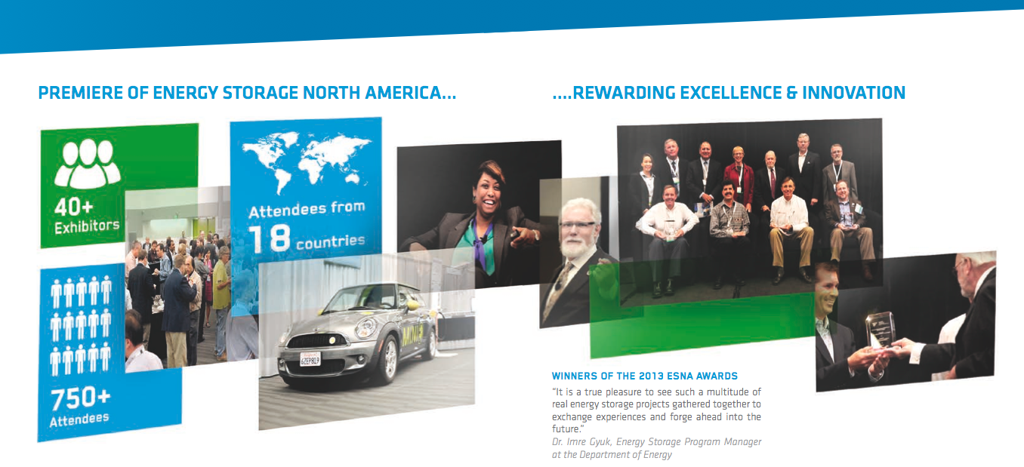
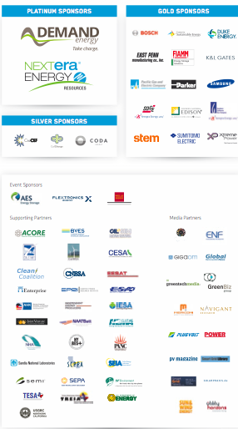
2014
SUCCESSFUL KICK-OFF IN 2013...
...REWARDING EXCELLENCE & INNOVATION
“I’ve been to a lot of conferences, and I’ve learned more at Energy Storage North America in the first four hours than I’ve learned at any other conference I’ve attended”
Phil Undercuffler, Director, Product Management and Strategy at OutBack Power Technologies
ESNA 2014 San Jose Convention Center
Sept 30 to Oct 2

Slide 46

More Information
Contact
  Janice Lin, Founder and Managing Partner, Strategen Consulting LLC
    Email: jlin@strategen.com
    Office: 510 665 7811
    Mobile: 415 595 8301
CESA Membership
  http://www.storagealliance.org/
Upcoming Events
  CESA Annual Invitation-Only Market Development Forum
    http://storagealliance.org/content/cesa-annual-market-development-forum-2014
  Energy Storage North America
    http://www.esnaexpo.com/

