Slide 1

CALIFORNIA’S PROGRESS IN RENEWABLE ENERGY November 2012
Michael Picker
Senior Advisor to the Governor for Renewable Energy Facilities

Slide 2
2012 Update Topics
Permits issued for Utility Scale in 2010/2011
Desert Renewable Energy Conservation Plan
Focus on Transmission/Revised MOU with Interior
Distributed Generation Roadmap
What’s Next

Slide 3
Governor Brown Renewable Energy Goals
Building 12,000 MW of Localized Electricity Generation
- Building 8,000 MW of Large Scale Renewables
- Planning and Permitting New Necessary Transmission Within 3 Years
- Dealing with Peak Energy Needs and Develop Energy Storage
- Timeline to Make New Homes and Commercial Buildings Zero Net Energy
- Making Existing Buildings More Efficient
- Adopting Stronger Appliance Efficiency Standards
- Increase Combined Heat and Power (COGEN) Production by 6,500 MW

Slide 4
Energy Action Plan: Loading Order
Energy efficiency
Demand response
Distributed generation
Renewable generation
Cleanest available fossil resources
Source: http://www.cpuc.ca.gov/PUC/energy/electric/energy+action+plan/

Slide 5
Projects Permitted in 2010-2011
County | Bio | Geothermal | PV | Solar Thermal | PV/Solar Thermal | Wind | Total
Alameda |  |  | 3 |  |  |  | 3
Contra Costa |  |  |  |  |  | 78 | 78
Fresno |  |  | 201 |  |  |  | 201
Imperial |  | 208 | 1,509 |  |  |  | 1,717
Kern | 44 |  | 2,772 | 250 |  | 4,102 | 7,168
Kings |  |  | 145 |  |  |  | 145
Los Angeles |  |  | 507 |  |  |  | 507
Merced |  |  | 150 |  |  |  | 150
Monterey |  |  | 2 |  |  |  | 2
Riverside |  |  | 725 | 1,734 |  | 5 | 2,464
Sacramento |  |  | 2 |  |  |  | 2
Santa Barbara |  |  |  |  |  | 56 | 56
San Benito |  |  | 401 |  |  |  | 401
San Bernardino |  |  | 248 | 770 | 633 |  | 1,651
San Diego |  |  | 45 |  |  |  | 45
San Luis Obispo |  |  | 800 |  |  |  | 800
Shasta |  |  |  |  |  | 102 | 102
Solano |  |  |  |  |  | 391 | 391
Stanislaus |  |  | 51 |  |  |  | 51
Tulare |  |  | 110 |  |  |  | 110
Yolo |  |  | 1 |  |  |  | 1
Total | 44 | 208 | 7,672 | 2,754 | 633 | 4,734 | 16,045 MW

Slide 6

New Technologies and Old Technologies

Slide 7
RPS Generation Under Contract

Slide 8
Queue currently holds more than double the generation capacity needed to achieve a 33% RPS

Slide 9
REPG, REAT & DRECP
Renewable Energy Policy
Group (REPG)
Office of the Governor
Office of the Secretary of Interior
DRECP Steering Committee
California Energy Commission
Department of Fish and Game
California Resources Agency
Bureau of Land Management
US Fish and Wildlife Service
Renewable Action Team (REAT)
California Energy Commission
U.S. Bureau of Land Management
California Department of Fish and Game
U.S. Fish and Wildlife Service
SCIENCE
PANEL
STAKEHOLDER INPUT

Slide 10
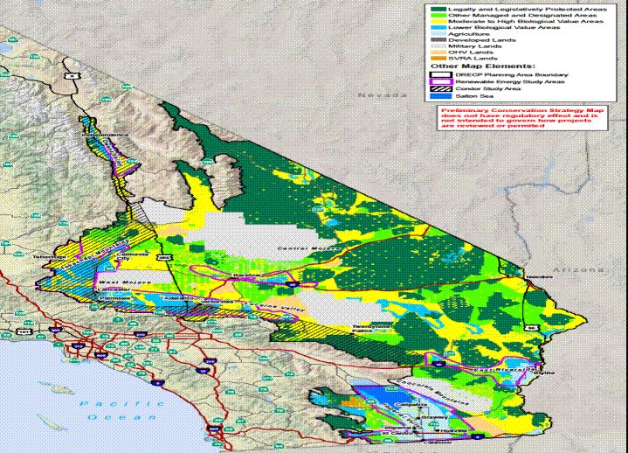
DRECP Preliminary Conservation Strategy
Mojave & Colorado
Desert Eco-regions
Counties include:
Imperial
Inyo
Kern
Los Angeles
Riverside
San Bernardino
San Diego
~ 22,587,000 acres

Slide 11
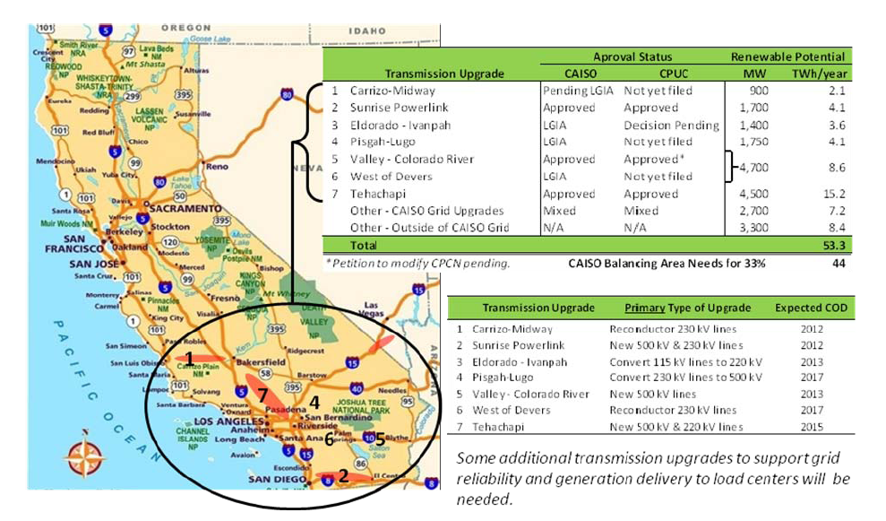
CA transmission upgrades can deliver renewable requirements (CA ISO March, 2011)

Slide 12
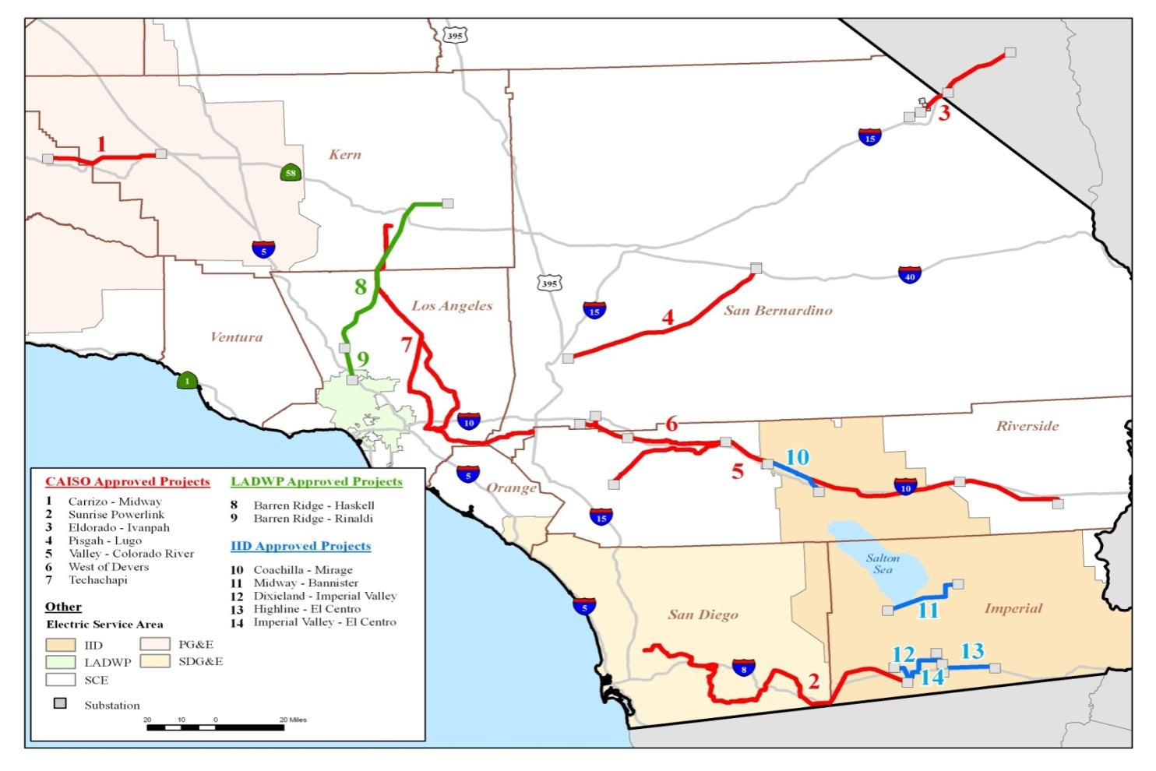
CTPG Renewables Transmission Projects (February, 2011)

Slide 13
Distributed Generation Roadmap
What renewable energy power projects are counted toward the Governor’s goal?
How much generation is already operating, pending or authorized?
How should the remainder of the Governor’s 12,000 MW goal be achieved?
How do we make expansion local renewable energy more efficient, effective and equitable?

Slide 14
Definition of Distributed Generation
Fuels and technologies accepted as renewable for purposes of Renewable Portfolio Standard
Sized up to 20 MW
Located within low-voltage distribution grid or supply power directly to consumer

Slide 15
Operational, Pending or Authorized
Total Online, Pending, and Capacity Authorized: 4,998.522MW
Total Online, Pending, and Capacity Authorized: 3,000MW
7,998.52MW
12,000MW Goal
7,998.52MW Current total
4,001.48MW remaining

Slide 16
Adaptive Program for Remainder
Implement and track existing programs:
Which add reliability and/or avoid transmission?
Which are most effective in cost containment?
Which produce the most generation most quickly?
Which are administratively efficient?
Which support other state policies (RPS, DR?)
Which maintain diversity of resources?
Develop and expand on programs that fit integrated resource planning.

Slide 17
Projects 20MW & Under in CAISO, PG&E, SCE, and SDG&E Interconnection Study Queues
Fresno
93 Projects
Supply: 504 Projects
Demand: ~30 Projects
(1 out of 17)
Tulare
31 Projects
Kings
33 Projects
San Bernardino
110 Projects
Kern
117 Projects
Los Angeles
89 Projects
Riverside
25 Projects
Source: Presentation by Seth Israel, Recurrent Energy, 12/2/2011 at Clean Green Local Power Conference
San Diego
4 Projects
Imperial
2 Projects

