Slide 1
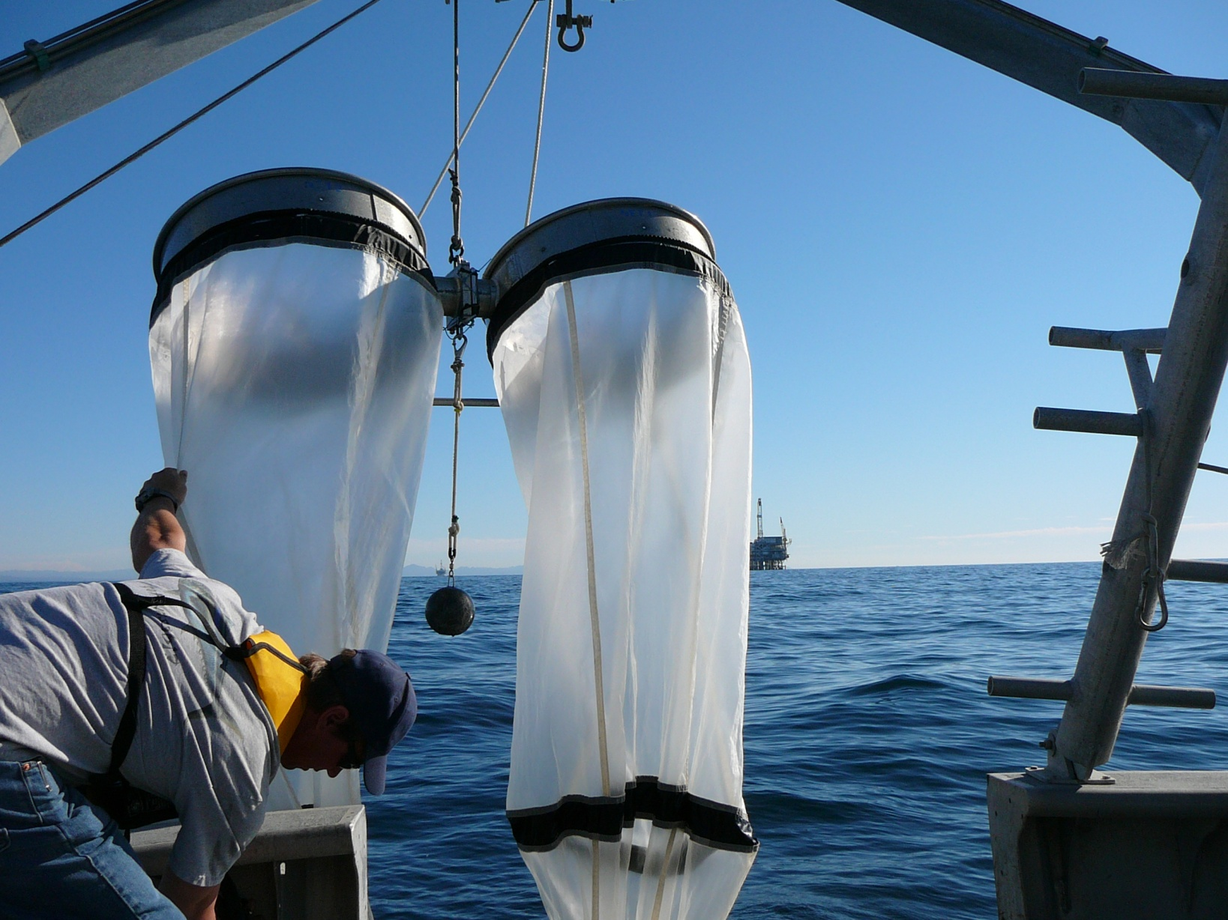
Assessment and mitigation approaches for once through cooling: Entrainment

Slide 2
Overview of current approach
Definitions and major assumptions
Models for assessing entrainment related impact
Adult equivalent loss (AEL)
Fecundity Hindcast (FH)
Empirical Transport Model (ETM)
Area of Production Foregone (APF)
Mitigation estimation using ETM/APF

Slide 3
Definitions and major assumptions
Entrainment – organisms brought into plant as part of once through use of water
Plankton – Organisms most subject to ‘ordinary’ entrainment
Meroplankton – a very small (often larval) stage in the life of certain organisms, for example: abalone, sea urchins, crabs, fish
Meroplankton have the potential for entrainment related impacts
Holoplankton – a very small organism that is planktonic for its whole life, for example: diatoms, dinoflagellates, certain crustaceans
Vastly more abundant than meroplankton
Not generally considered in entrainment related impact studies. Populations considered to suffer no impact from entrainment.
100% through plant mortality – all entrained organisms are assumed to die

Slide 4
Thermal Effects, Impingement and Entrainment
Power Plant
Warm cooling
water and high
velocity kills
small organisms
and propagules
(eggs, larvae and
spores)
20º F
Warm water exits plant to open ocean
Fish (and
Other organisms
entrained
from source waters
Traveling Screens impinge
larger organisms
Trash (fish and other organisms
lost to impingement)

Slide 5
Estimation of larval losses due to entrainment
Calculate volume of cooling water entering the plant per year (V)
Measure concentration of larvae (number per volume) that are entrained (N)
Assume no survival of larvae through the plant – then
NV = the annual loss of larvae due to entrainment
V
N

Slide 6
Models for assessing entrainment related impact (FH and AEL)

Slide 7
The problems with FH and AEL
Life history information (age specific mortality) for FH and AEL is not available for all species, and there is a high degree of uncertainty usually associated with the information. Historically, adult equivalents are the core of most impact assessments.
ETM uses an very different approach that is similar to the methods used by fishery scientists to determine effects of fishing on a population.

Slide 8
Empirical Transport Model (ETM) Understanding “Source Water Body” (SWB) and “Proportional Mortality” (P_{M})
The SWB is that spatial area that contains the larvae at risk of entrainment.
Source Water Body

Slide 9
Empirical Transport Model (ETM) Understanding “Source Water Body” (SWB) and “Proportional Mortality” (P_{M})
P_{M} is the percentage of the larvae at risk in the source water that are entrained and killed (e.g. 12%).
Source Water Body

Slide 10
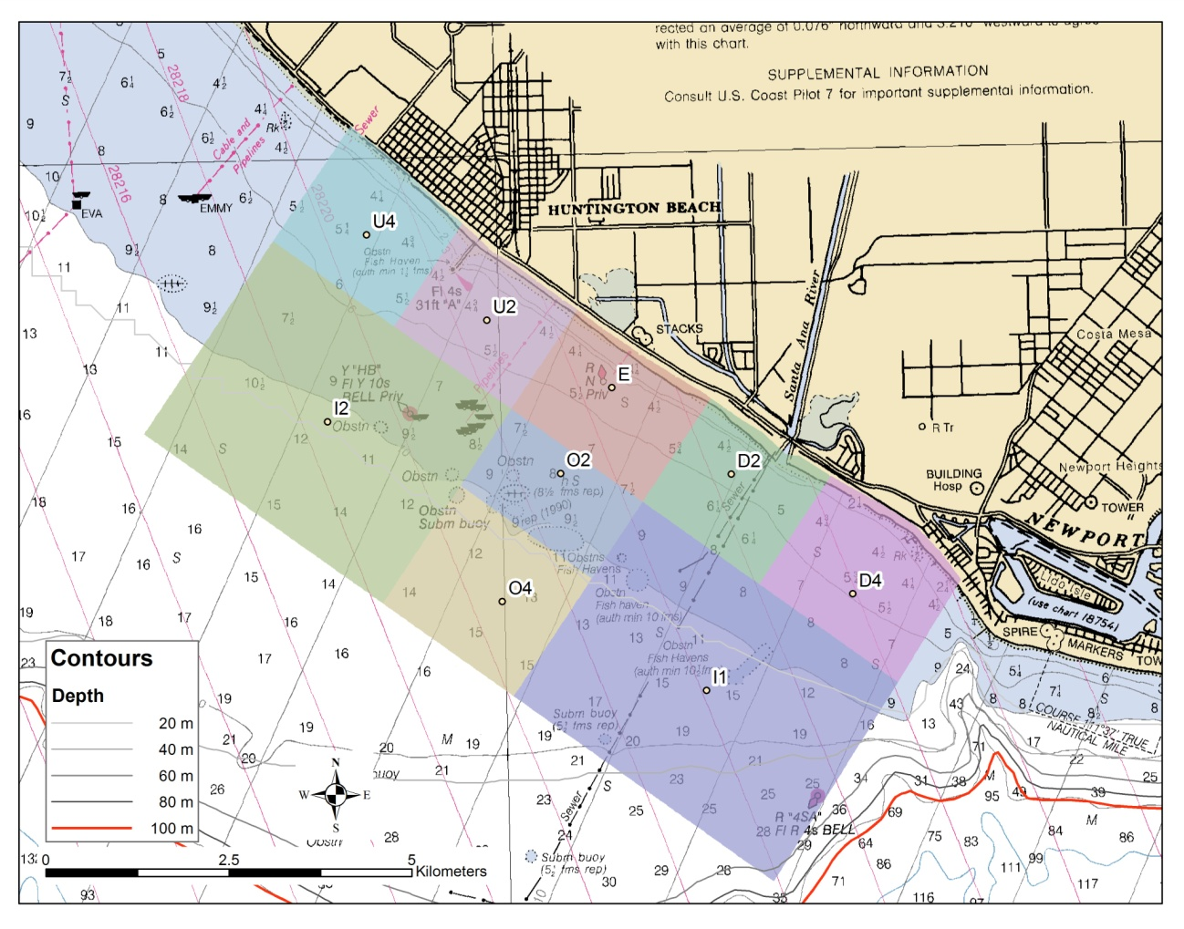
Generalized sampling design

Slide 11
Each species will have a different Source Water Body Example: queenfish (50.9 miles along coast)
Based on:
Period of vulnerability to entrainment
Distance larvae could have come from during the period of vulnerability
sampling area
SWB

Slide 12
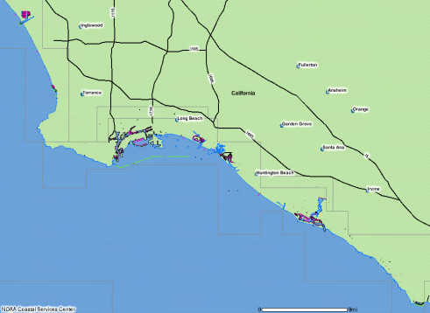

ETM Results
(SWB)
1) Assume that impacts to target species are representative of impacts to other similar species from the same habitats that were not analyzed
2) These values represents the estimated rate of mortality for all species having a larval phase whose P_{M}'s were not directly determined

Slide 13
Area of Production Foregone – a way to interpret loss
Simple method allows for conversion of organismal loss to habitat
P_{M} x SWB
where, the SWB is the habitat within the total SWB associated with larval production for a species.

Slide 14
Area of Production Foregone – a way to interpret loss
Both ETM and APF work for species with very limited life history information
No habitat lost or damaged due to entrainment – APF converts entrainment loss to habitat necessary to fully compensate for production lost due to entrainment
Covers both direct and indirect effects resulting from entrainment
Currency is habitat, which can be monetized
Hence, compensatory mitigation may be expressed in terms of water use

Slide 15
Entrainment Study ETM and APF results
Taxon | Estimated Annual Entrainment | ETM Estimate of P_{M} Alongshore Extrapolation (Mean) |  | Length of Source Water Body (Miles) | Area (mi²) of Production Foregone (Mean)
spotfin croaker | 69,701,589 | 0.30% |  | 10.1 | 0.085
queenfish | 17,809,864 | 0.60% |  | 50.9 | 0.911
white croaker | 17,625,263 | 0.70% |  | 28.7 | 0.583
black croaker | 7,128,127 | 0.10% |  | 11.6 | 0.039
salema | 11,696,960 | NA**
blennies | 7,165,513 | 0.80% |  | 7.7 | 0.170
diamond turbot | 5,443,118 | 0.60% |  | 10.1 | 0.170
California halibut | 5,021,168 | 0.30% |  | 18.5 | 0.131
rock crab | 6,411,171 | 1.10% |  | 15.9 | 0.486
AVERAGE (sq. miles) |  |  |  |  | 0.325
AVERAGE (acres) |  |  |  |  | 208
Based on units 3-4 (acres) |  |  |  |  | 104

