Slide 1
Investigating a Higher Renewables Portfolio Standard In California
Power Association of California Symposium
May 20, 2014
San Francisco, CA
  Nancy E. Ryan
  Director, Policy and Strategy

Slide 2
About the Study
Study sponsors:
  Los Angeles Dept. of Water & Power
  Southern California Edison Co.
  Pacific Gas and Electric Co.
  San Diego Gas & Electric Co.
  Sacramento Municipal Utility District
  Technical input from California ISO
Advisory panel:
  Dr. Dan Arvizu – Director and CEO of National Renewable Energy Laboratory
  Dr. Severin Borenstein – Director of the University of California Energy Institute and Co-Director of the Energy Institute at Haas School of Business, UC Berkeley
  Dr. Susan Tierney – Managing Principal at Analysis Group Inc., Boston, MA
  Mr. Stephen Wright – Retired Administrator, Bonneville Power Administration; General Manager, Chelan County Public Utility District
Analysis team: Energy + Environmental Economics (E3) with support from DNV KEMA & ECCO International
Available at: http://www.ethree.com/public_projects/renewables_portfolio_standard.php

Slide 3

Study focus: operational challenges from high renewable penetration (40-50%)
The CAISO duck chart illustrates operational challenges at 33% RPS
It shows just a single day in March as renewables rise to 33%
E3’s study looks at thousands of potential operating days as renewables rise to 50%
Core question: How serious and pervasive are operating challenges as renewable penetration rises above 33%?

Slide 4
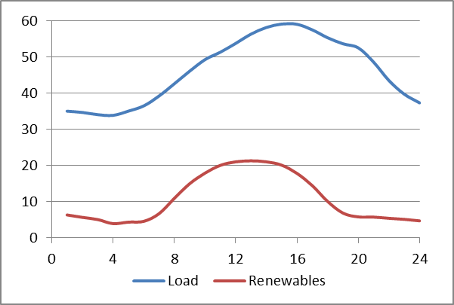
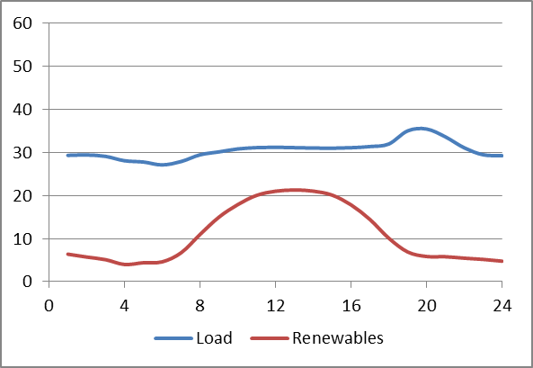
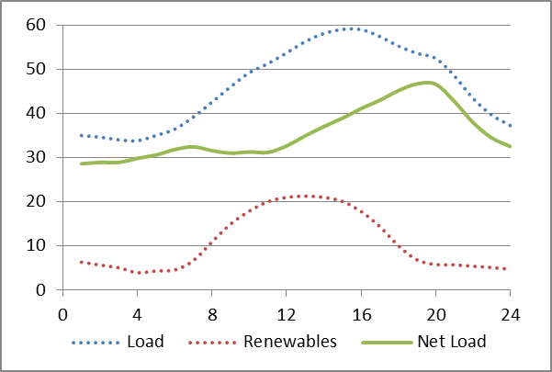
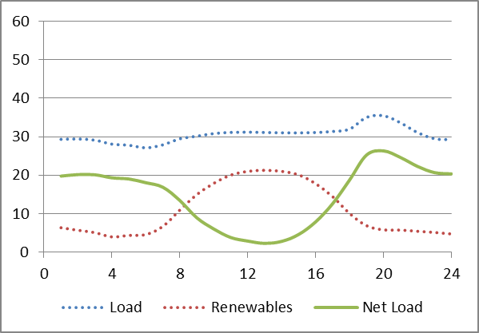
With higher renewables managing
Net Load will be the challenge
Sweltering Summer Day
“Dog Days”
Delightful Spring Day
“Duck Days”

Slide 5
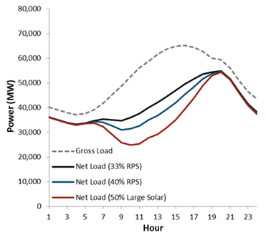
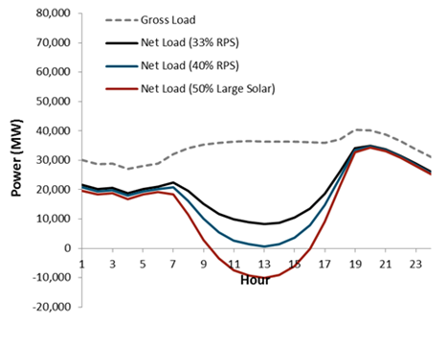
High Variable Renewable Penetration Stresses the Grid in New Ways
“Dog Days”
Highest Load Day
“Duck Days”
Highest Ramp Day
Historical system planning challenge: meet gross peak load on hottest days
High renewable penetration makes net peak lower and later
Need enough generating capacity
Historically an easy day to manage
Emerging system planning challenge: manage diurnal swings in net load
Need enough flexibility in the system

Slide 6
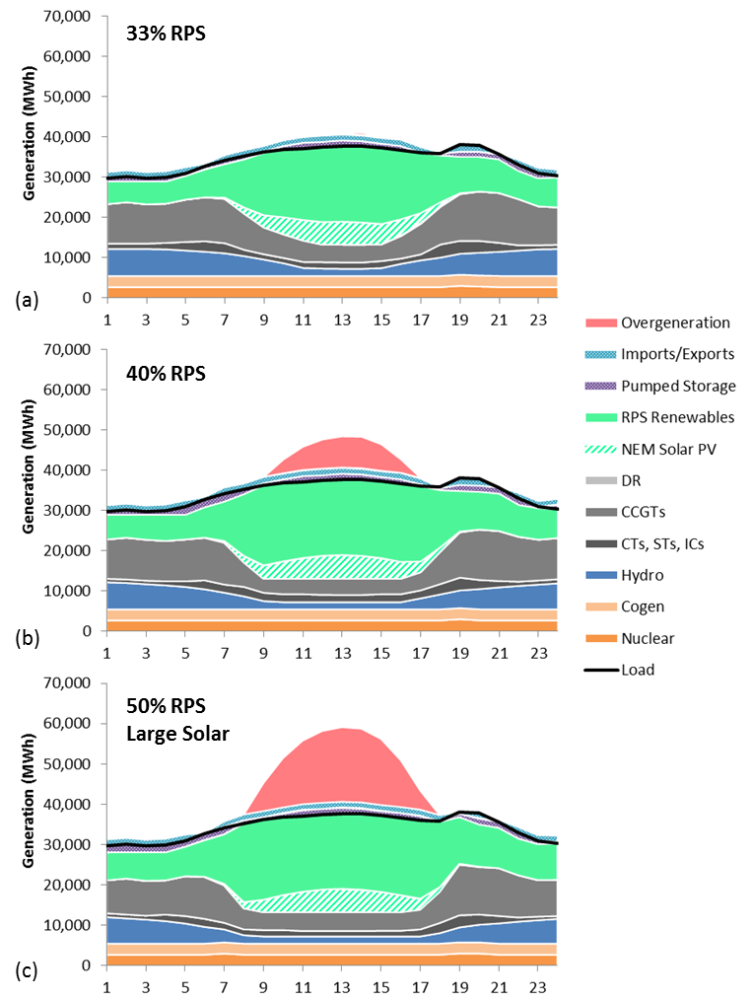
Example Day in April under 33%, 40% and 50% RPS
Chart shows increasing overgeneration above 33%
  Overgeneration is very high on some days under the 50% Large Solar case
  Fossil generation is reduced to minimum levels needed for reliability
Renewable curtailment is a critical strategy to maintain reliability
  Reduces overgeneration
  Mitigates ramping events

Slide 7
Overgeneration Is Extensive and Can Occur in Any Month
Average overgeneration (MW) by month-hour, 50% Large Solar Case:

Slide 8

E3 investigated several potential solutions, most were found to be effective
Potential solutions:
  Diversified portfolio (more wind and geothermal, less solar)
  Enhanced regional coordination
  Conventional demand response (down only)
  Advanced demand response (down and up)
  Energy storage
Solutions considered individually (each @ 5000 MW)
Solutions may be combined:
  Further study needed to identify optimal combination
  Best mix of solutions depends on renewable portfolio

Slide 9

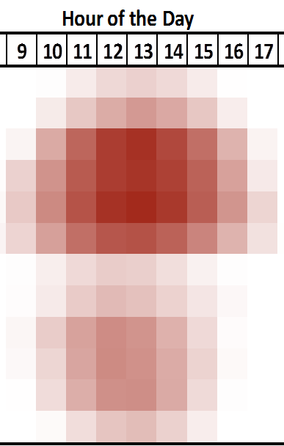
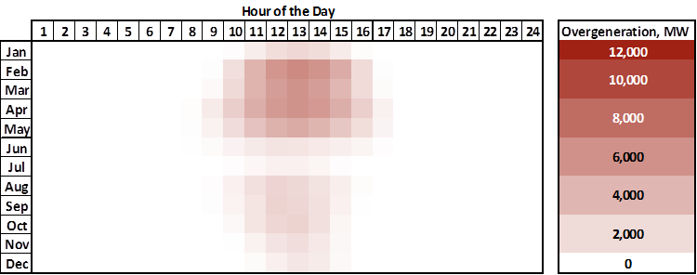
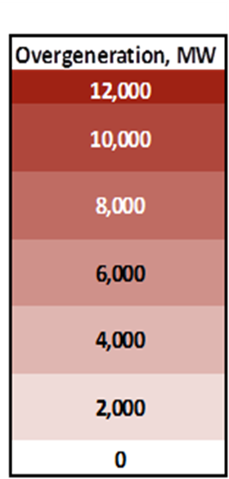
Overgen is less severe, frequent with diverse renewable portfolio
Average Hourly Overgeneration in 2030
Large Solar Case
Diverse Renewable Portfolio
…
…

Slide 10
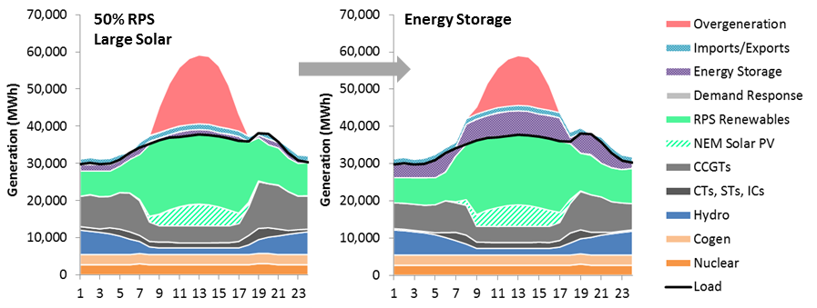
Potential Integration Solution:
Energy Storage Case
Assuming 5,000 MW of diurnal energy storage in CA reduces overgeneration from 9% in the 50% RPS Large Solar case to 4% of total renewable energy.
Storage charges during the day & discharges at night.
Example April day

Slide 11
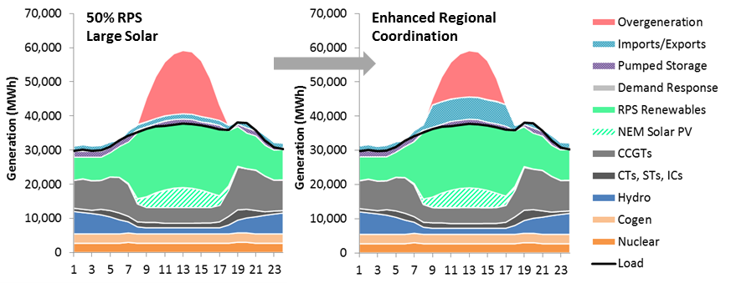
Potential Integration Solution:
Enhanced Regional Coordination Case
Increasing California’s export capability by 5,000 MW (6,500 MW total) reduces overgeneration from 9% in the 50% RPS Large Solar case to 3% of total renewable energy
Example April day

Slide 12
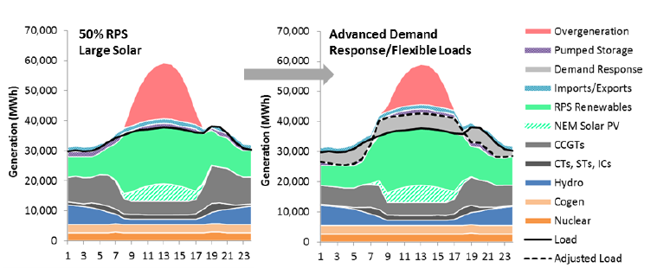
Potential Integration Solution:
Advanced Demand Response
Advanced DR can adjust load down and up
Conventional DR (downward only) does not help
Smart charging of EVs is a form of Advanced DR: cars charge during day at work and late at night at home

Slide 13
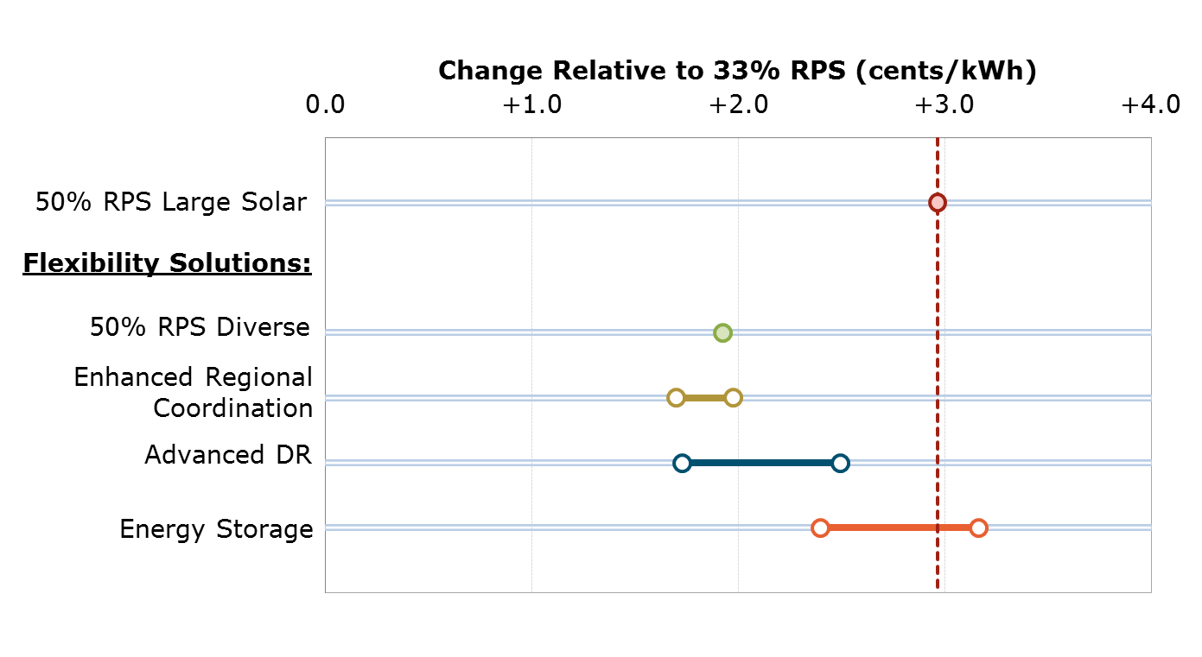
Change in Average Rates of Flexibility Solution Cases Relative to 33% RPS
(2012 cents/kWh)
5,000 MW of flexibility solutions reduce the cost of meeting a 50% RPS in 2030, but result in higher average rates compared to the 33% RPS scenario

Slide 14
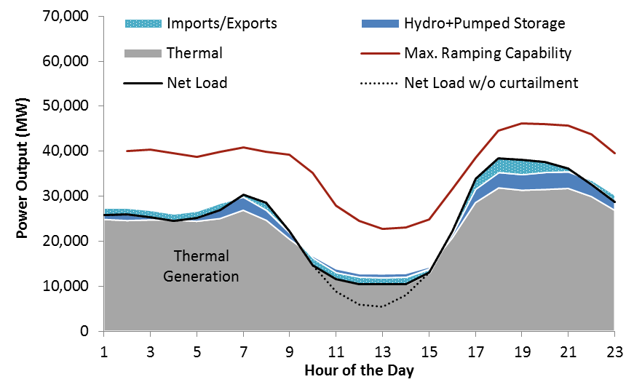
Insufficient downward flexibility of the system causes curtailment
Conventional fleet performance and flexibility Representative day with the largest net load ramp
Ramping capability always exceeds ramping need
Curtailment occurs because the system cannot ramp down low enough
50% RPS Large Solar Case, no flexibility solutions implemented

Slide 15
Potential Next Steps to Accommodate Higher Renewables
Increase regional coordination
  Allows sharing of flexible resources across West to support renewable integration
Pursue a diverse portfolio of renewable resources
Implement a long-term, sustainable solution to address overgeneration before the issue becomes more challenging
Implement distributed generation solutions
  Sustainable, cost-based procurement strategy; reexamination of retail rate design & net energy metering policy; distribution-level solutions and upgrades, including smart inverters with low-voltage ride-through capabilities that allow distributed PV to operate under grid faults

Slide 16
Thank You!
Energy and Environmental Economics, Inc. (E3)
101 Montgomery Street, Suite 1600
San Francisco, CA 94104
Tel 415-391-5100
Web http://www.ethree.com
Full Author List:
Arne Olson, E3
(arne@ethree.com)
Amber Mahone, E3
(amber@ethree.com)
Dr. Elaine Hart, E3
(elaine.hart@ethree.com)
Dr. Jeremy Hargreaves, E3
Ryan Jones, E3
Gabriel Kwok, E3
Nicolai Schlag, E3
Dr. Nancy Ryan, E3
Rod Frowd, ECCO
Dave Korinek, DNV KEMA
Dr. Ren Orans, E3

