Slide 1
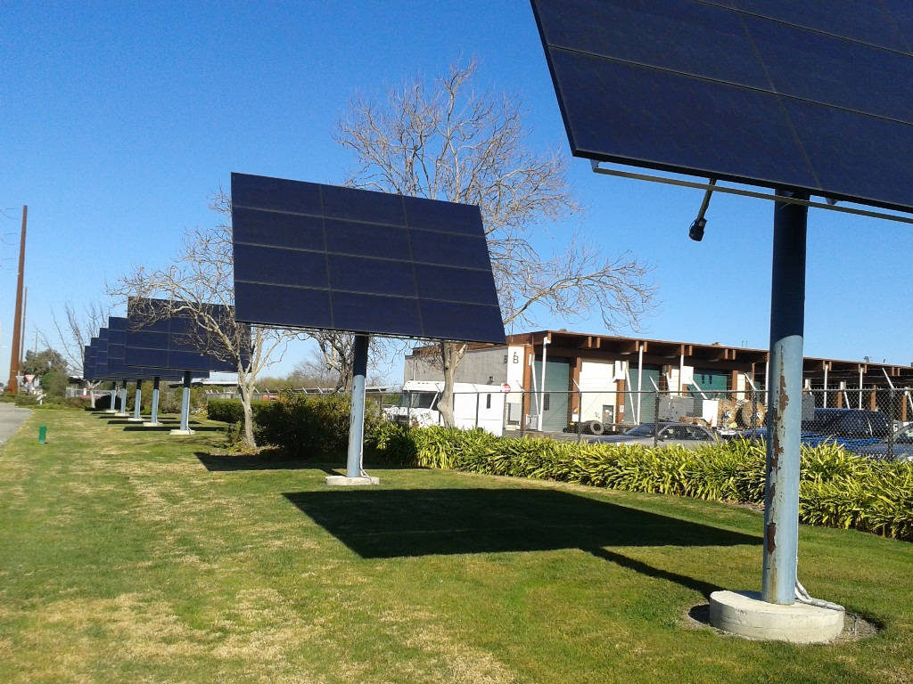
Managing Renewables Integration
Valerie Fong
Utilities Director
Power Association of Northern California
September 17, 2013

Slide 2
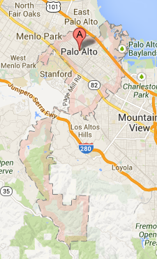
Palo Alto at a Glance
26 square miles
Territory runs from the SF Bay to the Foothills
Population: 64,000
Employment: >100,000
Approximately 29,500 customers (73,500 meters)

Slide 3
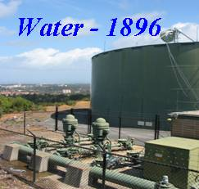
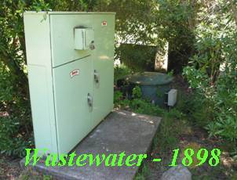

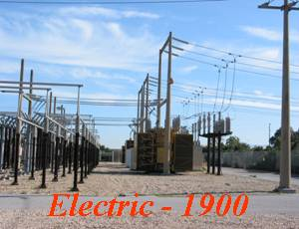
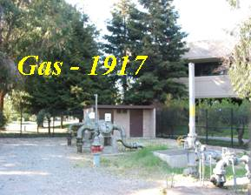
CPAU Delivers Five Utility Services

Slide 4

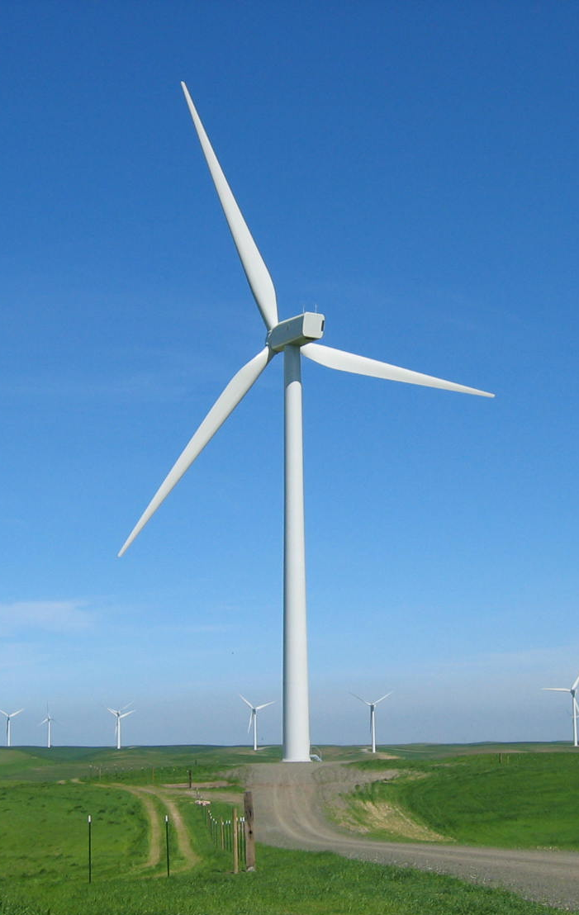
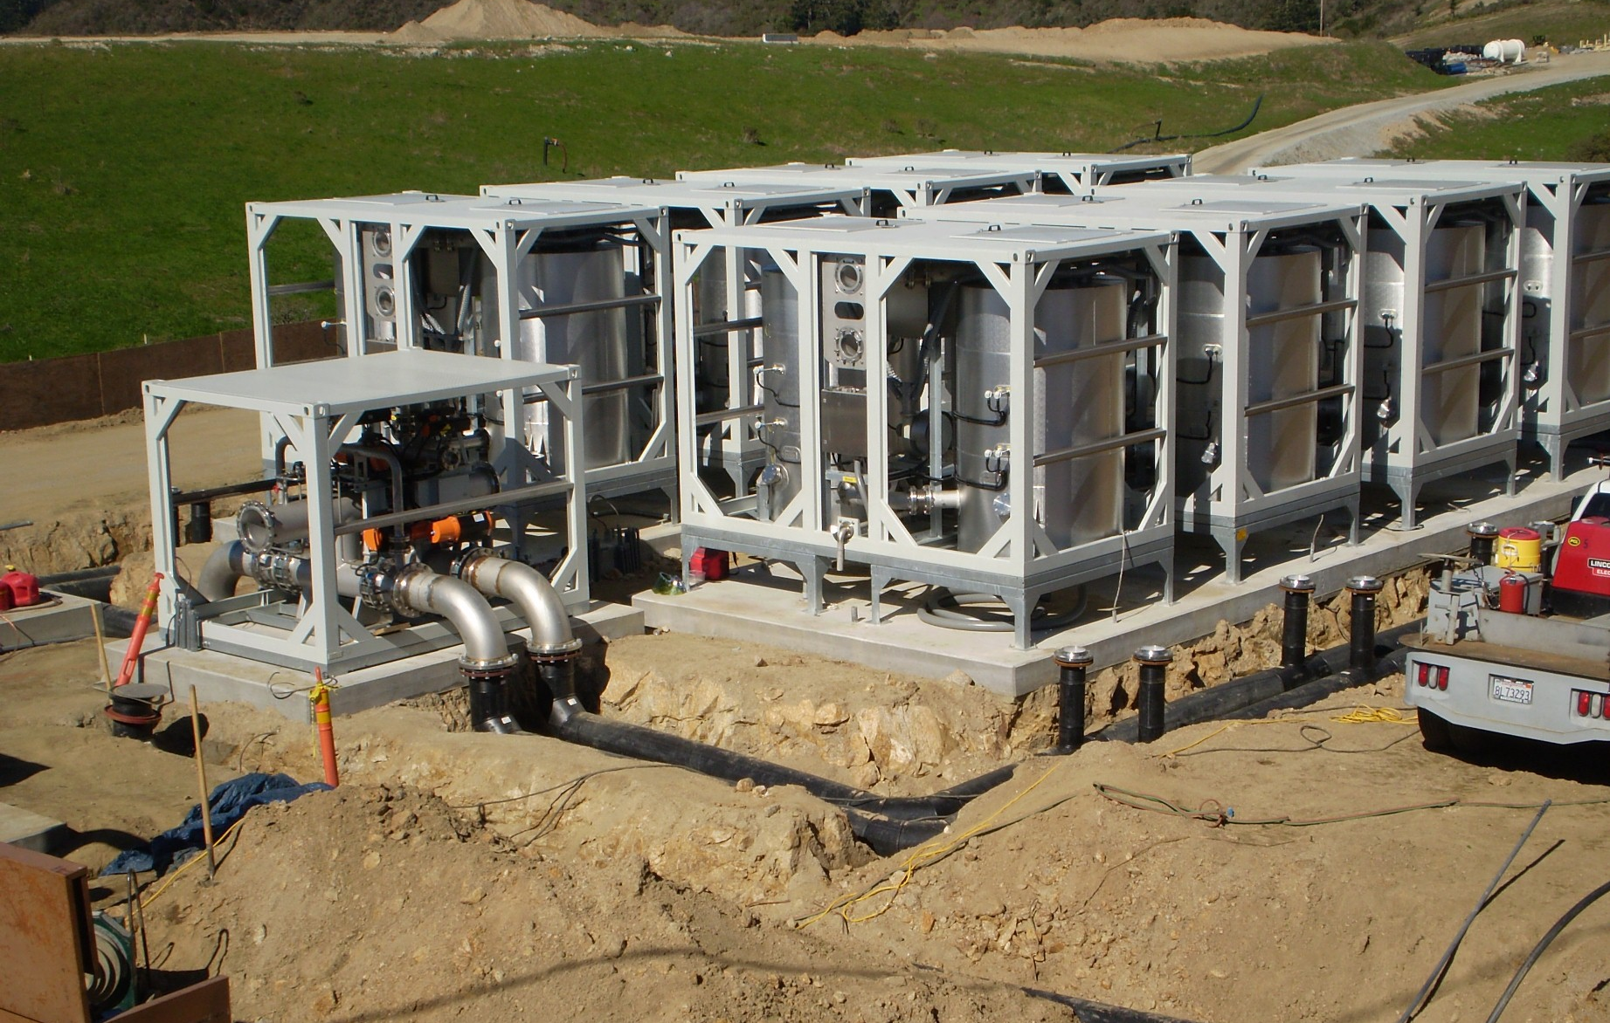
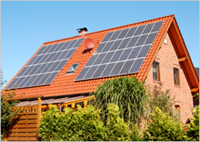
Palo Alto’s Electric Utility
Not CPUC regulated
City Council is decision-making authority
Annual load: ~1,000 GWh
Peak: 190 MW
Current Supply
Hydroelectric
Wind
Biogas (LFG)
Natural gas (and RECs)
Some local solar (NEM)
Future Supply
Large solar (utility scale)

Slide 5
Key Climate Policies & Initiatives
City’s Climate Protection Plan (2007)
Community-wide GHG emissions 15% below 2005 level by 2020
10-year Energy Efficiency Plan (2012)
4.8% cumulative EE by 2023
Renewable Portfolio Standard
Carbon Neutral Plan
PaloAltoGreen
Rebates for Roof-top Solar (PV Partners)
Feed-in Tariff Program (PaloAltoCLEAN)
Notes:
City’s Climate Protection Plan (2007)
Community-wide GHG emissions 15% below 2005 level by 2020
10-year Energy Efficiency Plan
X% by
Renewable Portfolio Standard
33% by 2015 with a rate impact up to 0.5 ¢/kWh
Carbon Neutral Electric Portfolio Plan
Achieved via Renewable Energy Credits with a rate impact up to 0.15 ¢/kWh
PaloAltoGreen
Rebates for Roof-top Solar (PV Partners)
Feed-in Tariff Program (PaloAltoCLEAN)

Slide 6
Palo Alto’s RPS History
California
20% by 2017
(SB 1078)
20% by 2010
(SB 107)
33% by 2020
(SB X1-2)
2002
2006
2007
2011
10% by 2008,
20% by 2015
20% by 2008,
30% by 2012,
33% by 2015
33% by 2015
Palo Alto
Palo Alto’s RPS is 33% by 2015 with a rate impact up to 0.5 ¢/kWh

Slide 7
Contracted RPS Resources
Notes:
Here’s a year-by-year look at how our renewable energy portfolio has grown and how we’re doing relative to our 33% by 2015 RPS goal and our carbon neutrality goal. In the past 12 months, our City Council has executed 4 PPAs for large scale solar projects in California. Assuming that these 4 projects come online in 2014 and 2016 as expected – and that the 1 other LFG project in our portfolio that are still in development also come online as predicted – our RPS level will be about 49% in 2017 – and we will achieve a carbon neutral electric supply portfolio entirely through long-term contracts for renewable power and hydro power.

Slide 8
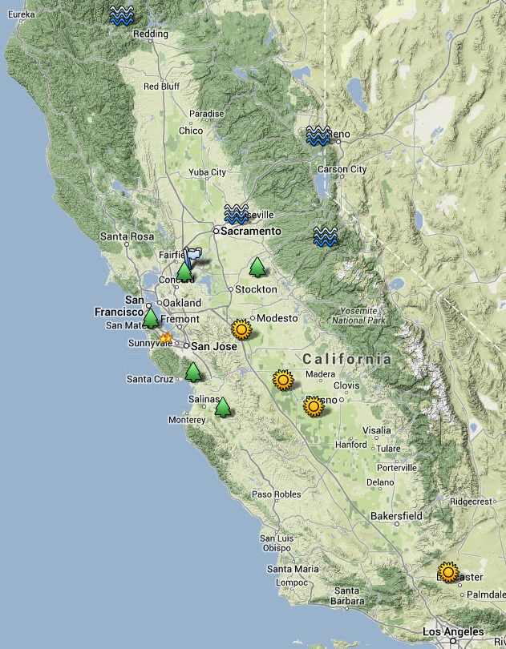



Palo Alto’s Renewable Resources
Solar Projects
Elevation Solar C
Western Antelope Blue Sky Ranch B
Frontier Solar
Brannon Solar
Wind Projects
High Winds
Shiloh Wind
Landfill Gas
Santa Cruz
Ox Mountain
Keller Canyon
Johnson Canyon
San Joaquin
Small Hydro
New Spicer Meadows
Lewiston, Nimbus, Stampede
Notes:
Solar PV project details (suns), going North to South:
Frontier Solar, developed by Ridgeline Energy, 20 MW, COD is 12/31/2016, price is $69/MWh flat (30 years)
Brannon Solar, developed by Trina Solar, 20 MW, COD is 8/1/2014, price is $77/MWh flat (25 years)
Elevation Solar C, developed by Silverado Power, 40 MW, COD is 12/31/2016, price is $68.77/MWh flat (30 years)
Western Antelope Blue Sky Ranch B, developed by Silverado Power, 20 MW, COD is 12/31/2016, price is $68.77/MWh flat (30 years)
Wind project details (blue flags – they’re so close together they basically overlap):
High Winds, operated by Iberdrola, we have a 20 MW share of a 162 MW project, began operating Dec 2004, price is $57.60/MWh flat for 23.6 years
Shiloh 1 Wind, operated by Iberdrola, we have a 25 MW share of a 150 MW project, began operating Jun 2006, price is $62.95/MWh flat for 15 years
Landfill Gas project details (green trees), going counter-clockwise from the one near Stockton:
San Joaquin landfill in Linden, 4 MW, COD is Nov 2013, price is $101/MWh escalating at 1.5% per year
Keller Canyon landfill in Pittsburg, 3.8 MW (of which we get 50%), began operating Aug 2009, price is $62.50/MWh escalating at 1.5% per year
Ox Mountain landfill in Half Moon Bay, 10 MW (of which we get 50%), began operating Apr 2009, price is $52/MWh escalating at 1.5% per year
Santa Cruz landfill, 3 MW (of which we get 50%), began operating Feb 2006, price is $54.95/MWh escalating at 1.5% per year
Johnson Canyon landfill in Gonzales, 1.4 MW (we get 100% of it), began operating May 2013, price is $109/MWh escalating at 1.5% per year
All 5 projects are with Ameresco & are 20 year terms
Small Hydro project details (blue waves), going counter-clockwise from the one furthest South:
New Spicer Meadows (near Murphys), 6 MW (of which we receive about 23%), owned/operated by NCPA
Nimbus Powerhouse (near Folsom), 15 MW, owned/operated by WAPA
Lewiston Powerhouse (near Lewiston), 0.44 MW, owned/operated by WAPA
Stampede Powerhouse (near Sierraville), 4.05 MW, owned/operated by WAPA

Slide 9
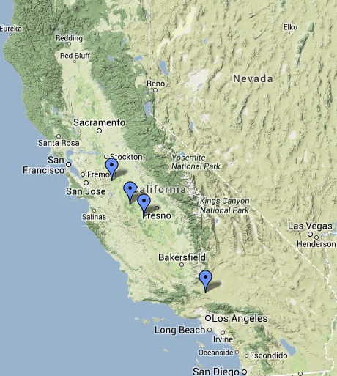
Palo Alto’s Solar PPAs
4 solar PPAs executed in last 10 months
Weighted average price: $70.40/MWh
100 MW_{AC} total
25-30 year terms
1 COD in late 2014
3 CODs in late 2016
Notes:
Project details, going North to South:
Frontier Solar, developed by Ridgeline Energy, 20 MW, COD is 12/31/2016, price is $69/MWh flat
Brannon Solar, developed by Trina Solar, 20 MW, COD is 8/1/2014, price is $77/MWh flat
Elevation Solar C, developed by Silverado Power, 40 MW, COD is 12/31/2016, price is $68.77/MWh flat
Western Antelope Blue Sky Ranch B, developed by Silverado Power, 20 MW, COD is 12/31/2016, price is $68.77/MWh flat

Slide 10
Price and Value Factors Considered
Price (Green premium);
Project viability (stage of development, developer experience, developer financial standing);
Daily and seasonal shape of the energy output;
Which RPS resource category (“bucket”), as defined by state law, the resource fits into;
Capacity value of the output;
Interconnection cost to get the output onto the grid;
Location; and
Start date;
Notes:
The Green Premium is our estimate of the cost premium associated with renewable energy purchases compared to wholesale “brown” power.
To calculate the Green Premium we compare the total levelized cost of each renewable resource to the wholesale market price of nonrenewable energy at the time that the contract for the resource is executed. In order to compare the brown power and green power prices on an apples-to-apples basis, we adjust the renewable energy resource’s purchase cost for its time-of-delivery, for any transmission costs we incur to get the power transmitted to the CAISO grid, and for any system or local capacity value provided by the resource. And we compare the brown power and green power costs on a levelized basis over the length of the renewable resource’s contract term.

Slide 11
Managing the Portfolio under Various Hydro Conditions
Surplus power to be sold – on a forward basis or on the spot market

Slide 12
Palo Alto’s Resource Supply Mix
In 2013 to achieve Carbon Neutrality, RECs will be purchased to cover Market Power
Notes:
PRE-PROPOSAL TELECON: 10:00 A.M.
Wednesday, September 25, 2013
RFP SUBMITTAL DEADLINE: 3:00 P.M.
Wednesday, October 9, 2013
CONTRACT ADMINISTRATOR: Carolynn Bissett
PROJECT MANAGER: Jim Stack
CITY OF PALO ALTO
PURCHASING/CONTRACT ADMINISTRATION
250 HAMILTON AVENUE
PALO ALTO, CA 94301
(650)

Slide 13
Palo Alto’s Carbon Neutral Plan
Palo Alto’s Definition:
A carbon neutral electric supply portfolio will demonstrate annual net zero greenhouse gas (GHG) emissions, measured at the Citygate, in accordance with The Climate Registry’s Electric Power Sector protocol for GHG emissions measurement and reporting.
Maximum rate impact of 0.15 ₵/kWh
Carbon Neutral starting in 2013
Relies on efficiency, local generation, existing hydroelectric and RPS resources
Un-bundled Renewable Energy Certificates (Bucket 3) used to neutralize “brown” market purchases

Slide 14
Electric Supply GHG Emissions

Slide 15
Renewable Energy Supplies & Green Premium Carbon neutrality with a total rate impact of 0.2 ¢/kWh, or about $0.80/month for a home
 | Generation (GWh/yr) | Green Premium ($000/yr)
Operating Projects | 209 | (293)
Committed, Not Yet Operating Projects | 264 | 2,248
Total Committed RPS Resources in 2017 | 473 or 49% RPS | 1,956 or 0.20 ¢/kWh
Median Residential Bill Impact ($/year) |  | $9.77

Slide 16

Palo AltoGreen
Voluntary renewable energy program, started in 2003
>21% of customers are on PaloAltoGreen
Ranked #1 in US for last 5 years
Sourced with Renewable Energy Credits
For calendar year 2013 only California Solar RECs
In the process of being redesigned given increasing RPS and Carbon Neutral Plan
Continue to allow customers to buy blocks of renewable resources
Green Gas via environmental offsets
Community solar programs

Slide 17
PV Partners Program
Rebates for Net Metered PV systems
Started 1999
Increased funding in 2007 (SB1)
6.5 MW goal by 2017
Current rebates:
Residential: $1/watt
Non-Res: $0.25/kWh paid over 5 years
Notes:
Another successful renewable energy program is our PV Partners rebate program which is similar to CA Solar Initiative program in the investor owned utility areas (PG&E).
Rebates for Net Metered PV systems
Started 1999, and we increased funding in 2007 after the million solar roofs bill was passed.
Our goal is 6.5 MW goal by 2017
Current rebates:
Residential: $1/watt
NonRes: $0.25/kWh
State goal 3,000 MW by 2017
3.7 MW in 536 installations (93% residential)
Net Metered PV has higher ROI (avoid future electric rate increases)
Installations don’t count toward Renew. Portfolio Standard

Slide 18
Clean Local Energy Accessible Now (CLEAN)
Fixed-price Feed-in Tariff paid for 20 year term
Interconnected on utility side of meter
CPAU buys electricity, renewable energy credits and capacity attributes
Meets Renewable Portfolio Standard goals
Price based on value of local renewable electricity to CPAU: 2013 price = 16.5 ¢/kWh
No minimum project size; 2 MW program capacity
No projects to date
Notes:
Once we identified the potential, we drafted the program concept.

Slide 19
Carbon Neutral – It’s Our Passion
https://vimeo.com/61055308

Slide 20
CONTACT INFORMATION
Valerie Fong, 650-329-2277
Valerie.Fong@cityofpaloalto.org

