Slide 1

Biological Aspects of OTC Compliance in California
October 15, 2013
John Steinbeck
Tenera Environmental
San Luis Obispo, CA
jsteinbeck@tenera.com

Slide 2
CA OTC Policy Two Options for Compliance
Track 1 – Reduce intake flow to levels achievable using wet-closed cycle cooling (93% flow reduction) and reduce through screen velocity to less than 0.5 fps
Track 2 – Reduce impingement mortality and entrainment (IM&E) to a level comparable (90%) to Track 1 using operational and/or structural controls
Must demonstrate Track 1 not feasible (can’t use cost)
Verification monitoring must demonstrate a 84% (90% of 93%) reduction in IM&E relative to design flow
If compliance based solely on flow the reductions must be compared on a monthly basis using actual average 2000-2005 flows
Monitoring required to verify 0.5 fps screen velocity

Slide 3
CA OTC Policy
For all plants: Measures must be implemented to mitigate the interim impingement and entrainment impacts resulting from the cooling water intake structure(s), commencing October 1, 2015 and continuing until final compliance.
Also, 36 months IM&E monitoring required for plants pursuing compliance under Track 2

Slide 4
Achieving Compliance
Compliance will require strategy that integrates technology and operational measures and maximizes biological data on entrainment
Species and sizes of fish larvae being entrained will affect choice of compliance technology
Seasonal and diel patterns of abundance affect options for operational adjustments of flow and decision for use of VSDs

Slide 5
Achieving Compliance
Data collected from the large number of studies in CA over the past decade will help inform compliance decisions
composition, size distribution, and morphology of fish larvae subject to entrainment
seasonal and diel patterns of larval abundance

Slide 6
Estimating Screen Effectiveness
CIQ goby
white croaker
body shapes vary among species
species composition varies across facilities

Slide 7
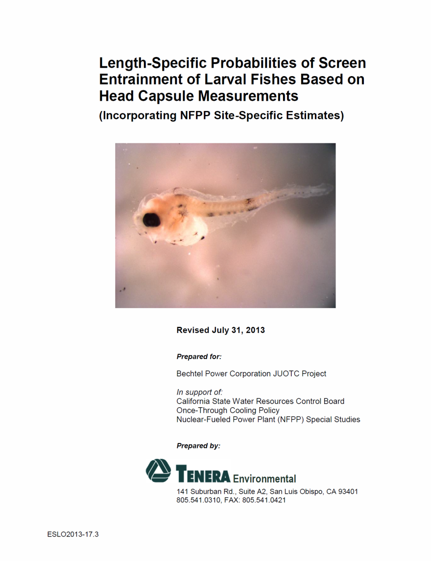
Estimating Screen Effectiveness
available at www.waterboards.ca.gov
Data on lengths and corresponding head capsule dimensions of larvae from numerous studies in CA used to estimate effectiveness of screens at reducing mortality

Slide 8
Estimating Screen Effectiveness
 | Square Mesh Opening
Length (mm) | 0.5 mm | 0.75 mm | 1.0 mm | 2.0 mm
1 | 1 (0) | 1 (0) | 1 (0) | 1 (0)
2 | 1 (0) | 1 (0) | 1 (0) | 1 (0)
3 | 1.000 (0.001) | 1 (0) | 1 (0) | 1 (0)
4 | 0.586 (0.308) | 1 (0) | 1 (0) | 1 (0)
5 | 0.011 (0.019) | 0.976 (0.034) | 1 (0) | 1 (0)
6 | 0 (0) | 0.481 (0.246) | 0.999 (0.001) | 1 (0)
7 | 0 (0) | 0.024 (0.028) | 0.894 (0.091) | 1 (0)
8 | 0 (0) | 0.000 (0.000) | 0.359 (0.175) | 1 (0)
9 | 0 (0) | 0 (0) | 0.030 (0.027) | 1 (0)
10 | 0 (0) | 0 (0) | 0.001 (0.001) | 1 (0)
11 | 0 (0) | 0 (0) | 0 (0) | 1.000 (0.000)
12 | 0 (0) | 0 (0) | 0 (0) | 0.993 (0.005)
13 | 0 (0) | 0 (0) | 0 (0) | 0.935 (0.035)
14 | 0 (0) | 0 (0) | 0 (0) | 0.722 (0.087)
15 | 0 (0) | 0 (0) | 0 (0) | 0.398 (0.093)
16 | 0 (0) | 0 (0) | 0 (0) | 0.141 (0.050)
17 | 0 (0) | 0 (0) | 0 (0) | 0.035 (0.016)
18 | 0 (0) | 0 (0) | 0 (0) | 0.005 (0.003)
19 | 0 (0) | 0 (0) | 0 (0) | 0.001 (0.000)
20 | 0 (0) | 0 (0) | 0 (0) | 0.000 (0.000)
Parameters from relationship of length and head capsule dimensions used to predict probability of entrainment for various length larvae

Slide 9
Estimating Screen Effectiveness
Studies have also provided extensive data on lengths of larvae susceptible to entrainment – not achievable from one study without very frequent sampling.
Need to account for protection of larger larvae.

Slide 10
Operational Controls
Patterns of seasonal and diel variation in larval abundance allow for implementation of operation controls that provide large reductions in entrainment

Slide 11
Operational Controls
We have worked with clients to develop a modeling tool that estimates levels of entrainment reductions provided by varying plant flow by month, hour, or on a diel basis.
Data from three-year monitoring will be useful in verifying that operational controls are providing the necessary entrainment reductions for compliance.

Slide 12
Summary
New and existing biological data on IM&E will be critical in developing a compliance strategy
Questions?
John Steinbeck
Tenera Environmental
jsteinbeck@tenera.com
805-541-0310

