Slide 1
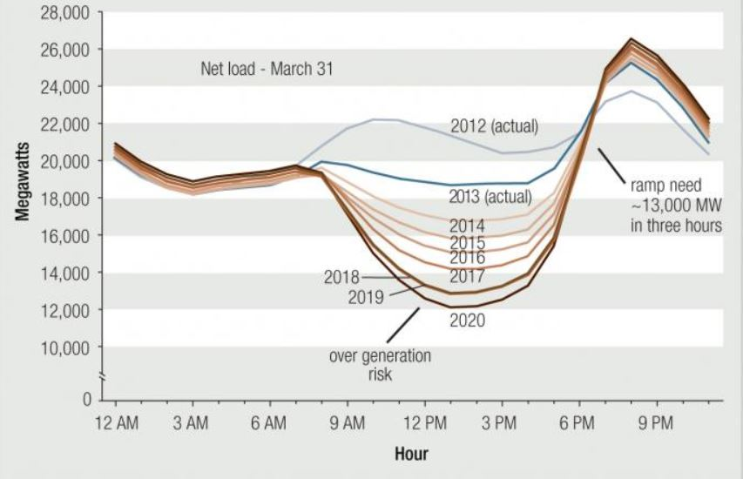
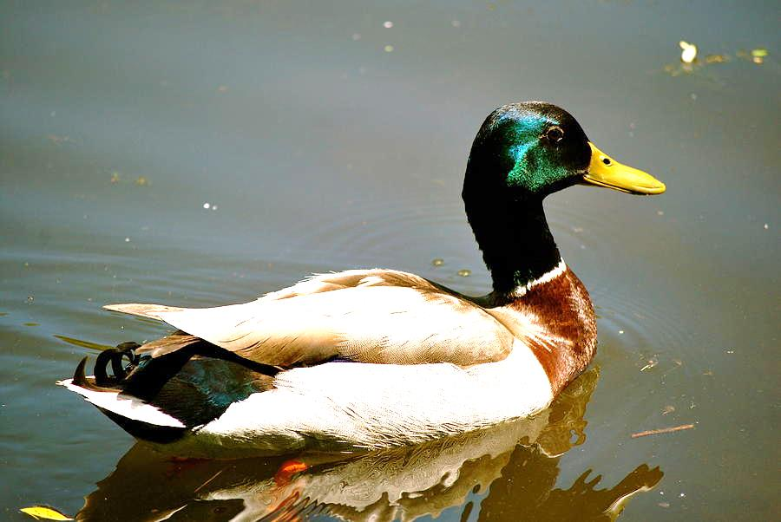
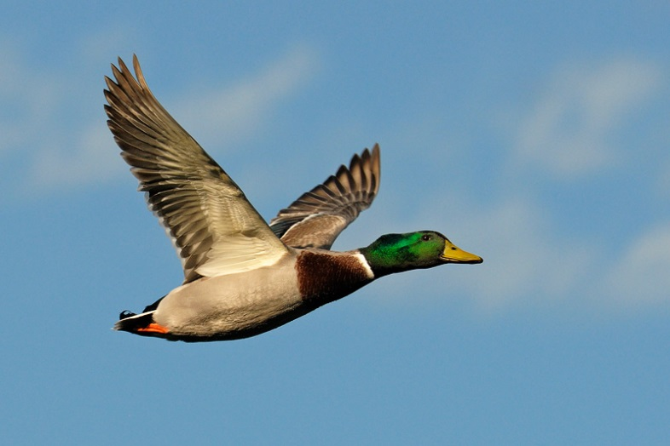
Figure 2
Duck Sitting in the Water
Figure 1
Figure 3
Duck in Flight
A duck in water tends to center its weight in the water, floating easily.
Figure 2 shows the duck shape commonly associated with the graph in Figure 1.
A duck in flight, however, stretches out its profile in order to create lower wind resistance in flight. This is illustrated in Figure 3.
Teaching the Duck to Fly, Jim Lazar, Regulatory Assistance Project, January, 2014

Slide 2
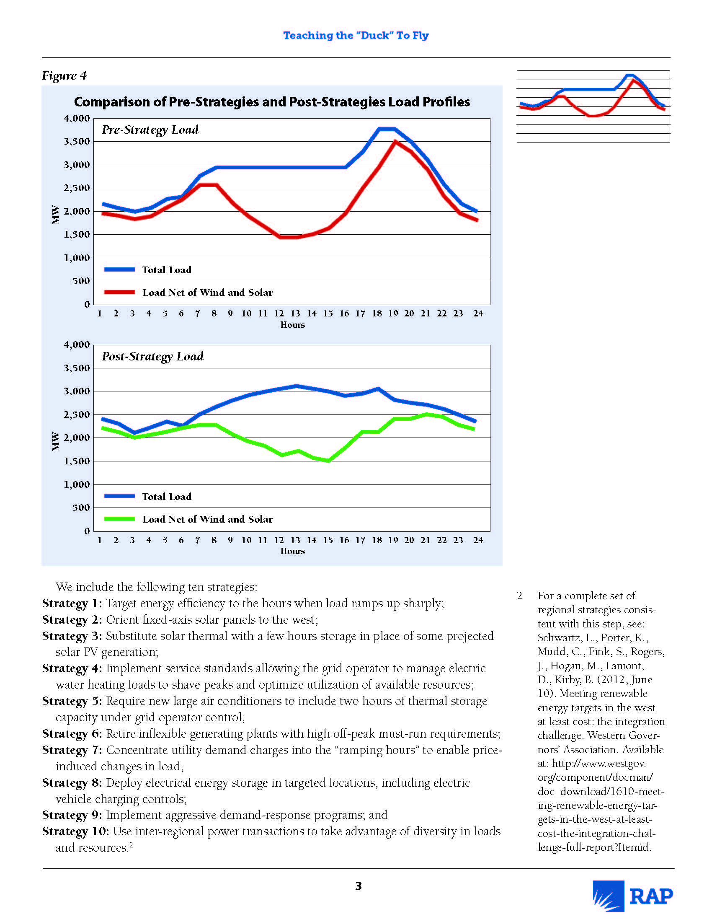
Ten Strategies to Align Loads to Resources
(and Resources to Loads)
Comparison of Pre-Strategies and
Post-Strategies Load Profiles
Targeted energy efficiency
Orient solar panels
Use solar thermal with storage.
Manage electric water heat
Require new large air conditioners to include storage
Retire older inflexible power plants
Concentrate rates into “ramping” hours
Deploy electricity storage in targeted locations
Implement aggressive demand response programs
Use inter-regional exchanges of power
Teaching the Duck to Fly, Jim Lazar, Regulatory Assistance Project, January, 2014

