Slide 1
2014: A Year of Crisis and Opportunity
Power Association of Northern California
Nov. 18, 2014 • Timothy Quinn, ACWA Executive Director

Slide 2
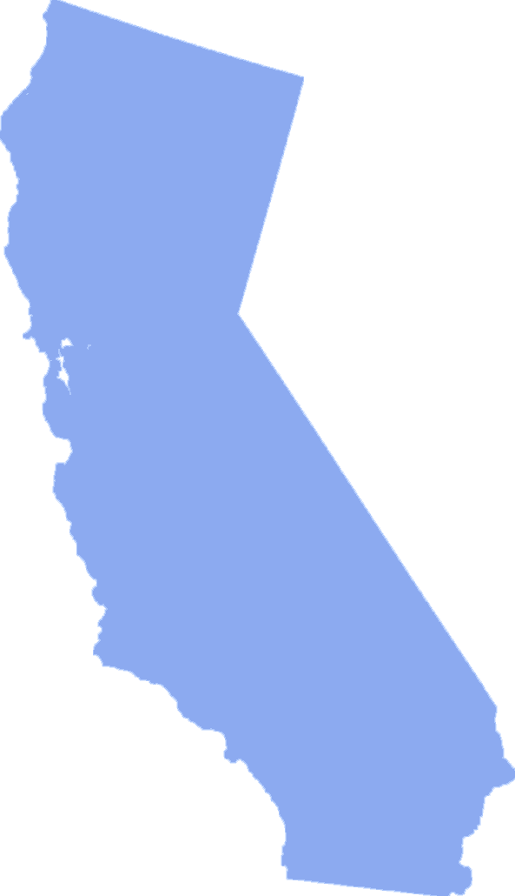
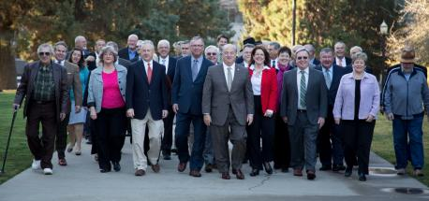
About ACWA
Who We Represent . . .
  ACWA members responsible for 90% of the state’s distributed water
    Water Sources & Services
    Federal, state and local projects
    Surface and groundwater
    Agricultural, urban, industrial customers
    Wholesale, retail

Slide 3
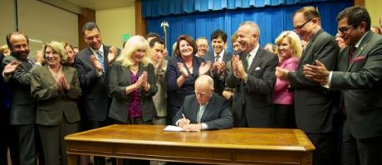
It Has Been a Big Year for California Water
Governor Outlines California Water Action Plan
Comprehensive Groundwater Legislation Passed and Signed by the Governor
Passage of Proposition 1 Water Bond by a 67% -33% Margin
Key Steps toward Advancing Comprehensive Plan

Slide 4
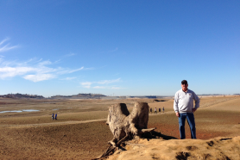
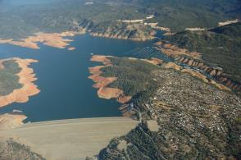
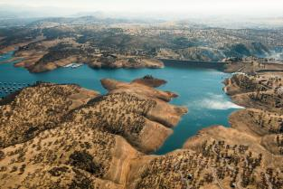
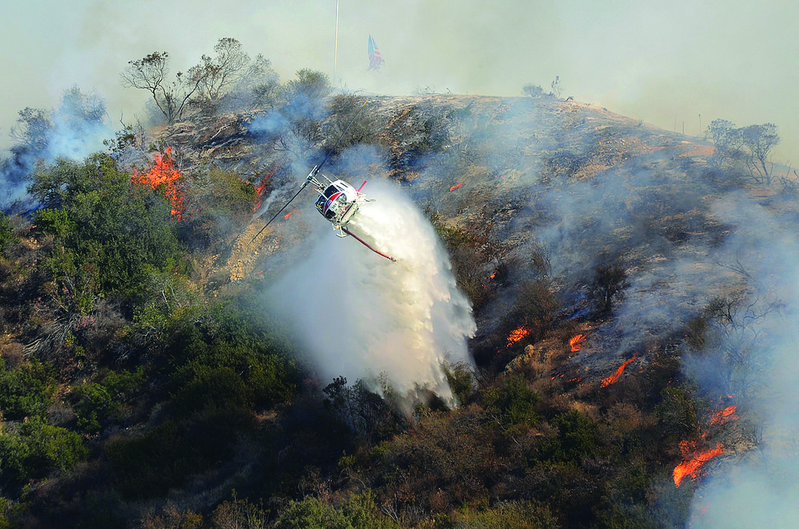
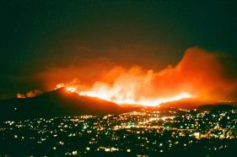
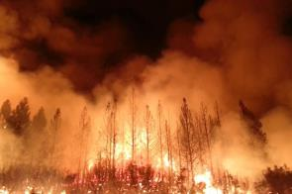
Drought Touches Everything

Slide 5
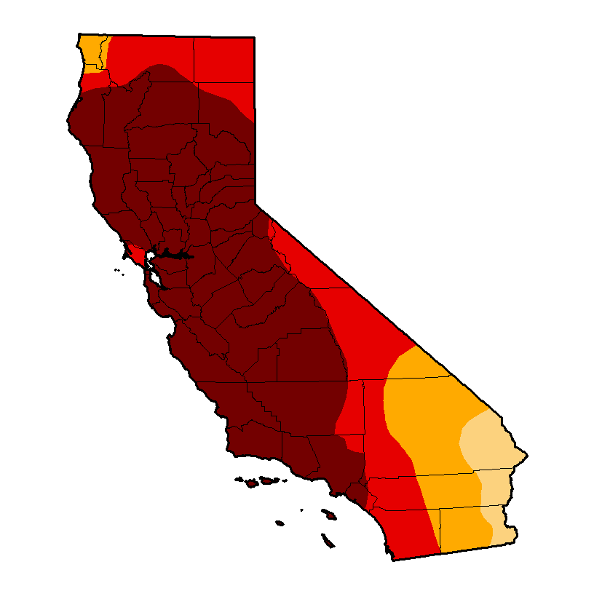
This Drought is Really Bad
Oct. 21, 2014
82% of state is now in Extreme Drought
58% is in Exceptional Drought

Slide 6
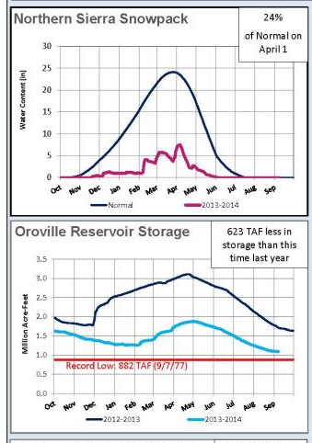
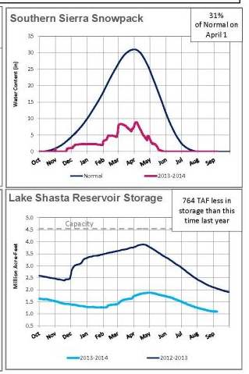
This Drought is Really Bad

Slide 7
Water and Energy are Interrelated
Water uses energy:
Pumping/Conveying water
Treating drinking water and wastewater
End customer uses like heating water for showers
Energy uses water:
Hydropower generation
Cooling power plants
Irrigating biofuel crops/ Washing solar panels

Slide 8
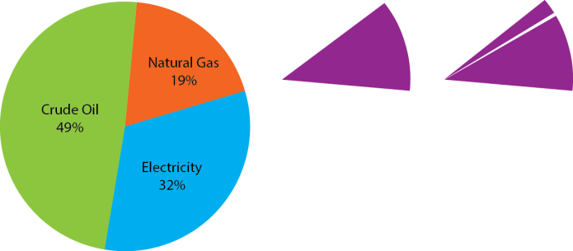
Water and Energy are Interrelated
Water uses energy:
Pumping/Conveying water
Treating drinking water and wastewater
End customer uses like heating water for showers
Energy uses water:
Hydropower generation
Cooling power plants
Irrigating biofuel crops/ Washing solar panels
Breaking down energy used for water:

Slide 9
Water and Energy are Interrelated
Water uses energy:
Pumping/Conveying water
Treating drinking water and wastewater
End customer uses like heating water for showers
Energy uses water:
Hydropower generation
Cooling power plants
Irrigating biofuel crops/ Washing solar panels
Breaking down energy used for water:
About 12% of the total energy used in the state is related to water

Slide 10
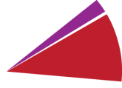
Water and Energy are Interrelated
Water uses energy:
Pumping/Conveying water
Treating drinking water and wastewater
End customer uses like heating water for showers
Energy uses water:
Hydropower generation
Cooling power plants
Irrigating biofuel crops/ Washing solar panels
Breaking down energy used for water:
2% of that is used for conveyance, treatment,
and distribution
(0.3% for the State Water Project,
1.7% for all other water systems)

Slide 11
Water and Energy are Interrelated
Water uses energy:
Pumping/Conveying water
Treating drinking water and wastewater
End customer uses like heating water for showers
Energy uses water:
Hydropower generation
Cooling power plants
Irrigating biofuel crops/ Washing solar panels
Breaking down energy used for water:
2% of that is used for conveyance, treatment,
and distribution
(0.3% for the State Water Project,
1.7% for all other water systems)
10% of that is used for
end-customer uses (heating, cooling, pressuring, industrial)

Slide 12
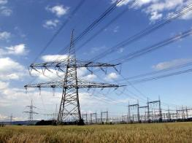
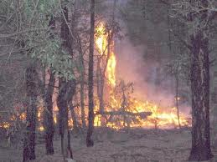
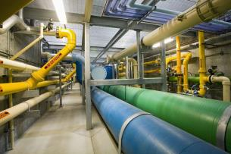
Shared Challenges
    Water and power agencies have shared challenges:
  Limited water and drought
  Increased population
  Climate change and
  higher temperatures
  Infrastructure and peak usage hours
  Regional variations

Slide 13
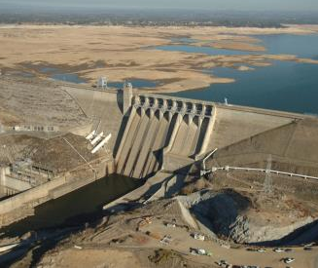
Drought and Hydroelectric Power
    Less water = less hydroelectric power generation
    Since 2011, California’s total in-state hydroelectric generation has been reduced by 45%
    Wildfires have further threatened hydroelectric plants and power transmission lines
    Improved small hydro technology may provide opportunities to do more with less
Source: California Energy Commission

Slide 14

Conservation Efforts
Water & Energy Conservation Toolkit
Educating the public
Tips on conserving both water and energy
Conservation methods can save water, wastewater, embedded energy, and end use energy

Slide 15
ACWA Energy Committee Priorities
New technologies for energy and water development
Embedded energy methodology
Strategic partnerships
Protecting and diversifying water supplies
Addressing energy issues while continuing to deliver safe, reliable water
Water and energy must work together to resolve this crisis

Slide 16
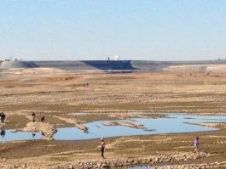
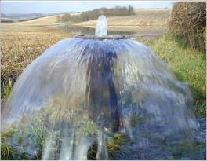
2014: Crisis and Opportunity
The Water Crisis Helps Focus Attention
In 2014, we have:
General agreement on a comprehensive statewide program
Framework for sustainable groundwater management
Passage of Proposition 1 Water Bond to jumpstart investments

Slide 17
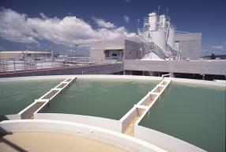
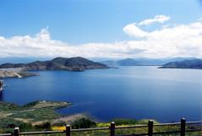
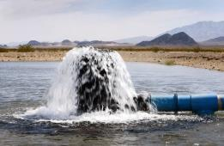
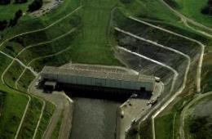
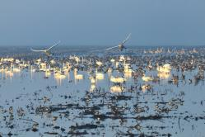
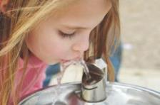
The Comprehensive Water Strategy
“In a Nutshell”
Conserve more
Store more
Fix the Delta
Manage groundwater
Provide safe drinking water
Invest in habitat and watersheds

Slide 18

Proposition 1: “Jump Starting” the Comprehensive Plan
Approved by Legislature and signed by governor Aug. 13
$7.545 billion measure replaced $11.14 billion bond previously set for ballot
Proposition 1 passed by voters on Nov. 4
Funding “jump starts” the Comprehensive Plan

Slide 19
2014 Water Bond
Total Expenditures = $7.545 billion

Slide 20
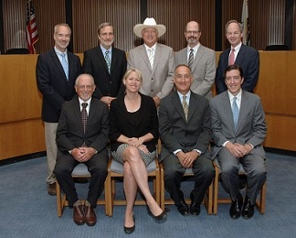
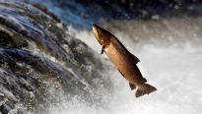
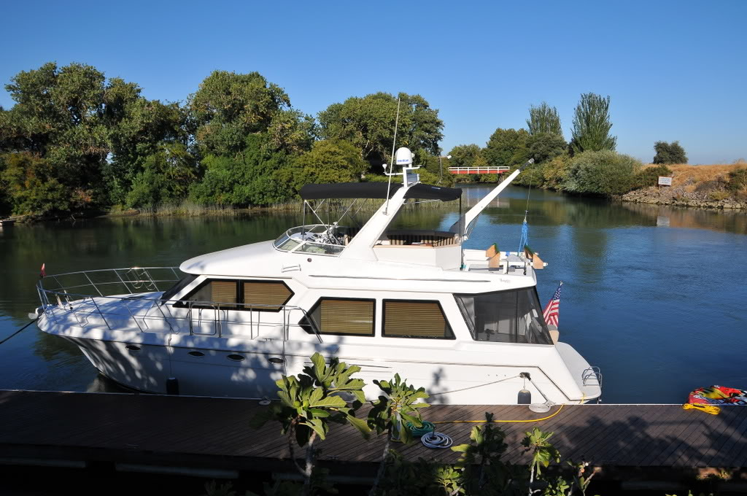
Prop 1 Funding for Water Storage
$2.7 billion continuously appropriated to California Water Commission
Competitive process to maximize public benefits
  Flows & temps for fish (>50%)
  Water quality
  Flood control
  Emergency Response
  Recreation
Funds for wider range of projects
  CALFED surface storage
  Other local/regional surface storage
  Groundwater storage
  Reoperation of existing storage
No funds for water supply benefits – must be paid by users

Slide 21
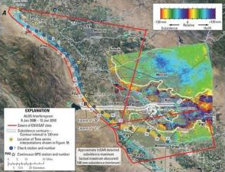
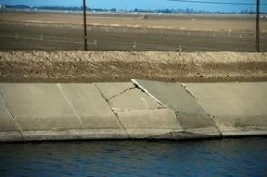
The Drought Has Worsened A Growing Groundwater Crisis
The groundwater crisis just won’t go away
Groundwater regulation is by far the most controversial issue in California today

Slide 22
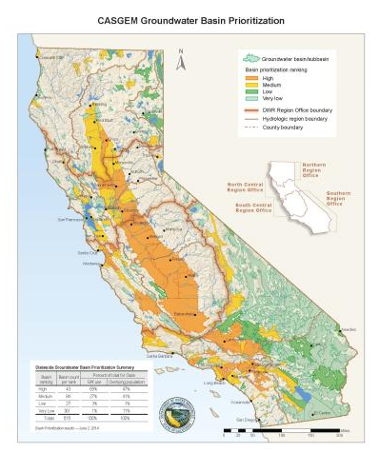
Sustainable Groundwater
Management Act of 2014
Requires Groundwater Sustainability Plans in high and medium basins
Authorizes management tools for local agencies
Creates state “backstop”
Defines time frame for accomplishing goals

Slide 23
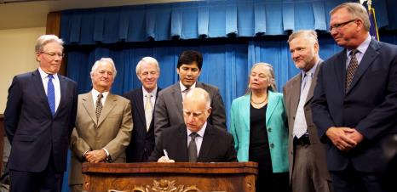
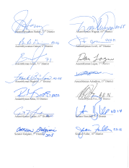
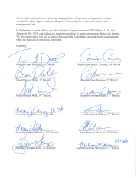
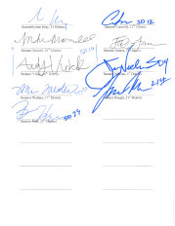
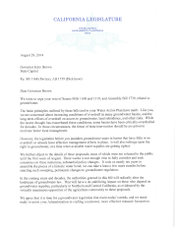
“Never Let a Good Crisis Go to Waste”
SGMA will profoundly change the statewide debate
ACWA policy: SGMA must be part of a comprehensive program
What needs to happen to assure sustainable groundwater and healthy local economies?

Slide 24
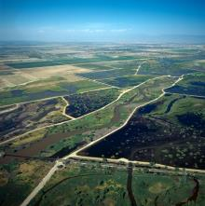
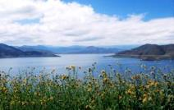
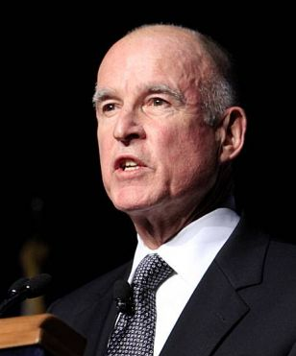
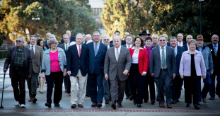
Visioning Success
Manage implementation through ACWA Groundwater Policy Group
Sharpen focus on comprehensive solutions through ACWA Storage Policy Task Force
Cooperate closely with Brown administration
2014 Will Be Viewed as a Critical Turning Point in California Water History

Slide 25

Contact & More Information
Timothy Quinn
ACWA Executive Director
timq@acwa.com
916.441.4545 • www.acwa.com

